Slide 1
Nebraska
Livestock Expansion
06.27.28

Slide 2
New and Innovative Food Chain Alliances
The Future:
An emerging new world

Slide 3
Opportunities for Dairy
Processing
30,000 cows

Slide 4
Opportunities for Beef
Innovative Models:
Finishing
Cow/Calf

Slide 5
Opportunities for Pork
30+ permits w/NDEQ
Lender/Leader meetings

Slide 6
Opportunities for Poultry
Broilers
Layers
Hatcheries
(laying hen, turkey)

Slide 7
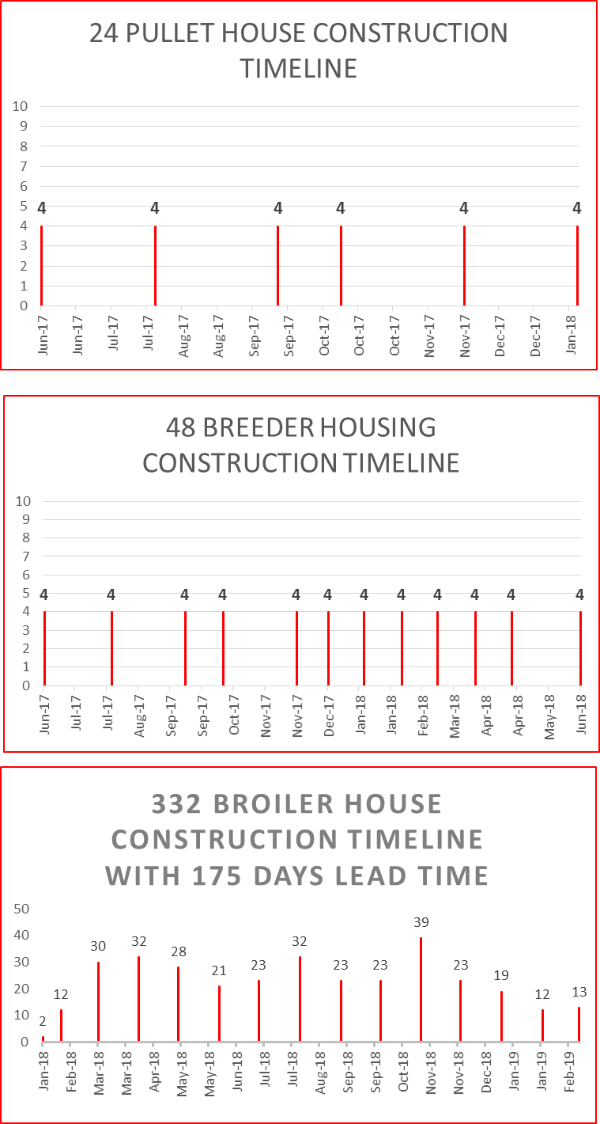
Lincoln Premium Poultry/Costco
Timeline:
Production: 8.20.2018
Pullet: 6.2017
Breeder: 6.2017
Broiler: Fall – 1.2018

Slide 8
Strategies:
Create Collaborative Community Efforts
Local Econ. Dev., Community Leadership, Elected Officials
YOU are the agricultural Expert
Identify strengths of community (LFC)
Prepare possible sites/ processing & production
Strategize permitting, construction, community awareness
Use available tools
Invite resources

Slide 9
Farmers and Ranchers DELIVER Campaign
F
Farmersdeliver.com

Slide 10
AFAN
Willow Holoubek
402-710-1110
willowh@a-fan.org
Emily Skillett
402-421-4416
emilys@a-fan.org

