Slide 1
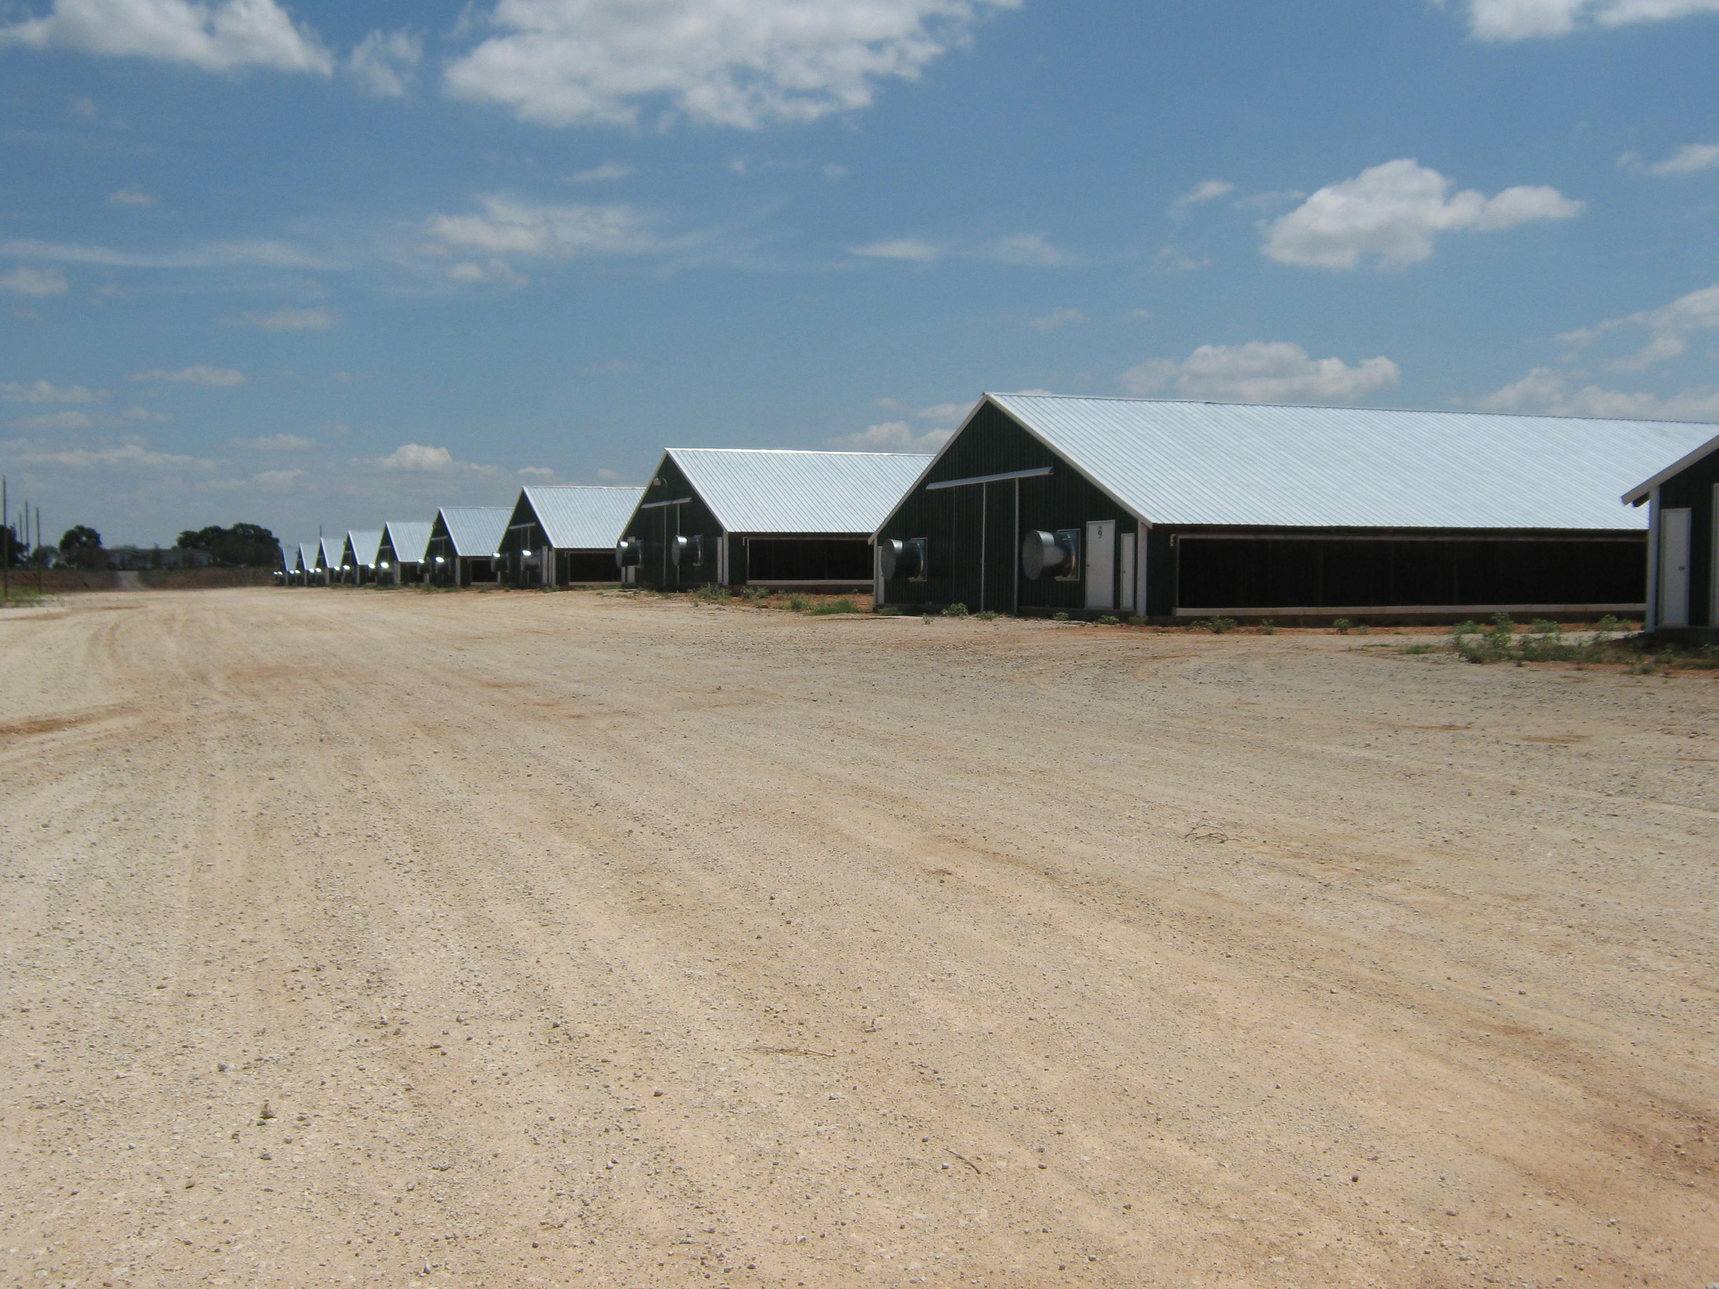


Key Considerations When Siting New Poultry Barns
Josh Payne, Oklahoma State University
Susan Watkins, University of Arkansas

Slide 2
Presentation based on a fact sheet prepared by Chris Hall, Reliable Poultry Springdale, AR

Slide 3
Notes:
Source: ODAFF
Cash receipts
Success attributed to integrators from NW Arkansas

Slide 4
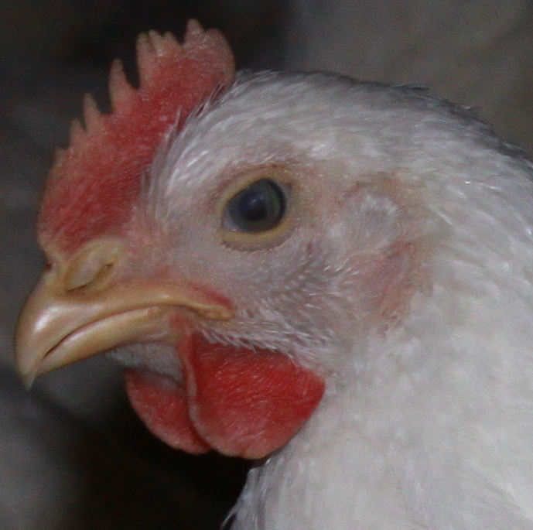
Farm Site Considerations
Site Selection
Property Setbacks & Easements
Neighbors
Vegetative Buffers
Manure Management
Roads
Bridges
Utilities
Water Quality (Wells)

Slide 5
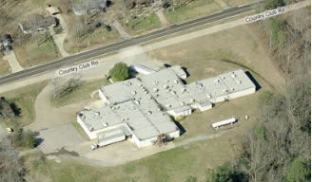
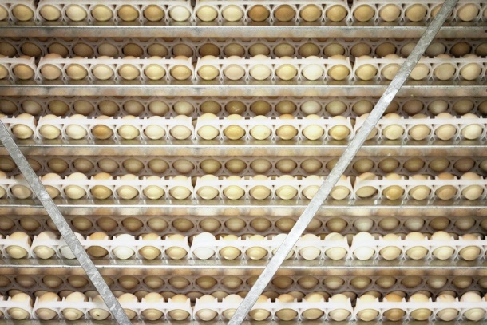
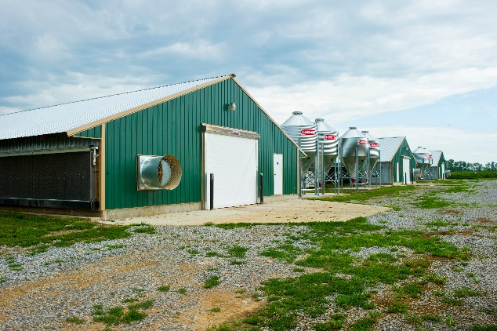
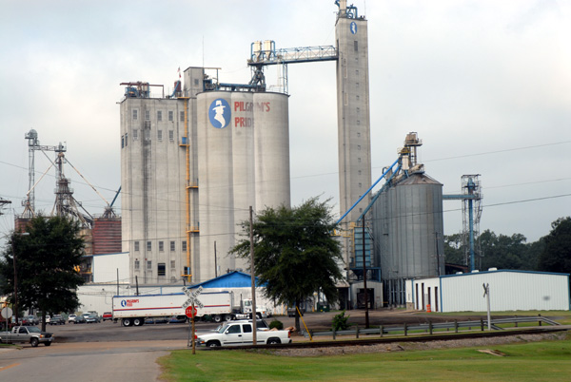
Site Selection
Processing Plant
Hatchery
Poultry Farm
Discuss proposed location with the company to ensure it is within desired range for feed trucks, live haul and service
Target a 25-50 mile range or less from farm to feed mill
Companies will consider expanding further if not enough housing in target range
Feed Mill

Slide 6
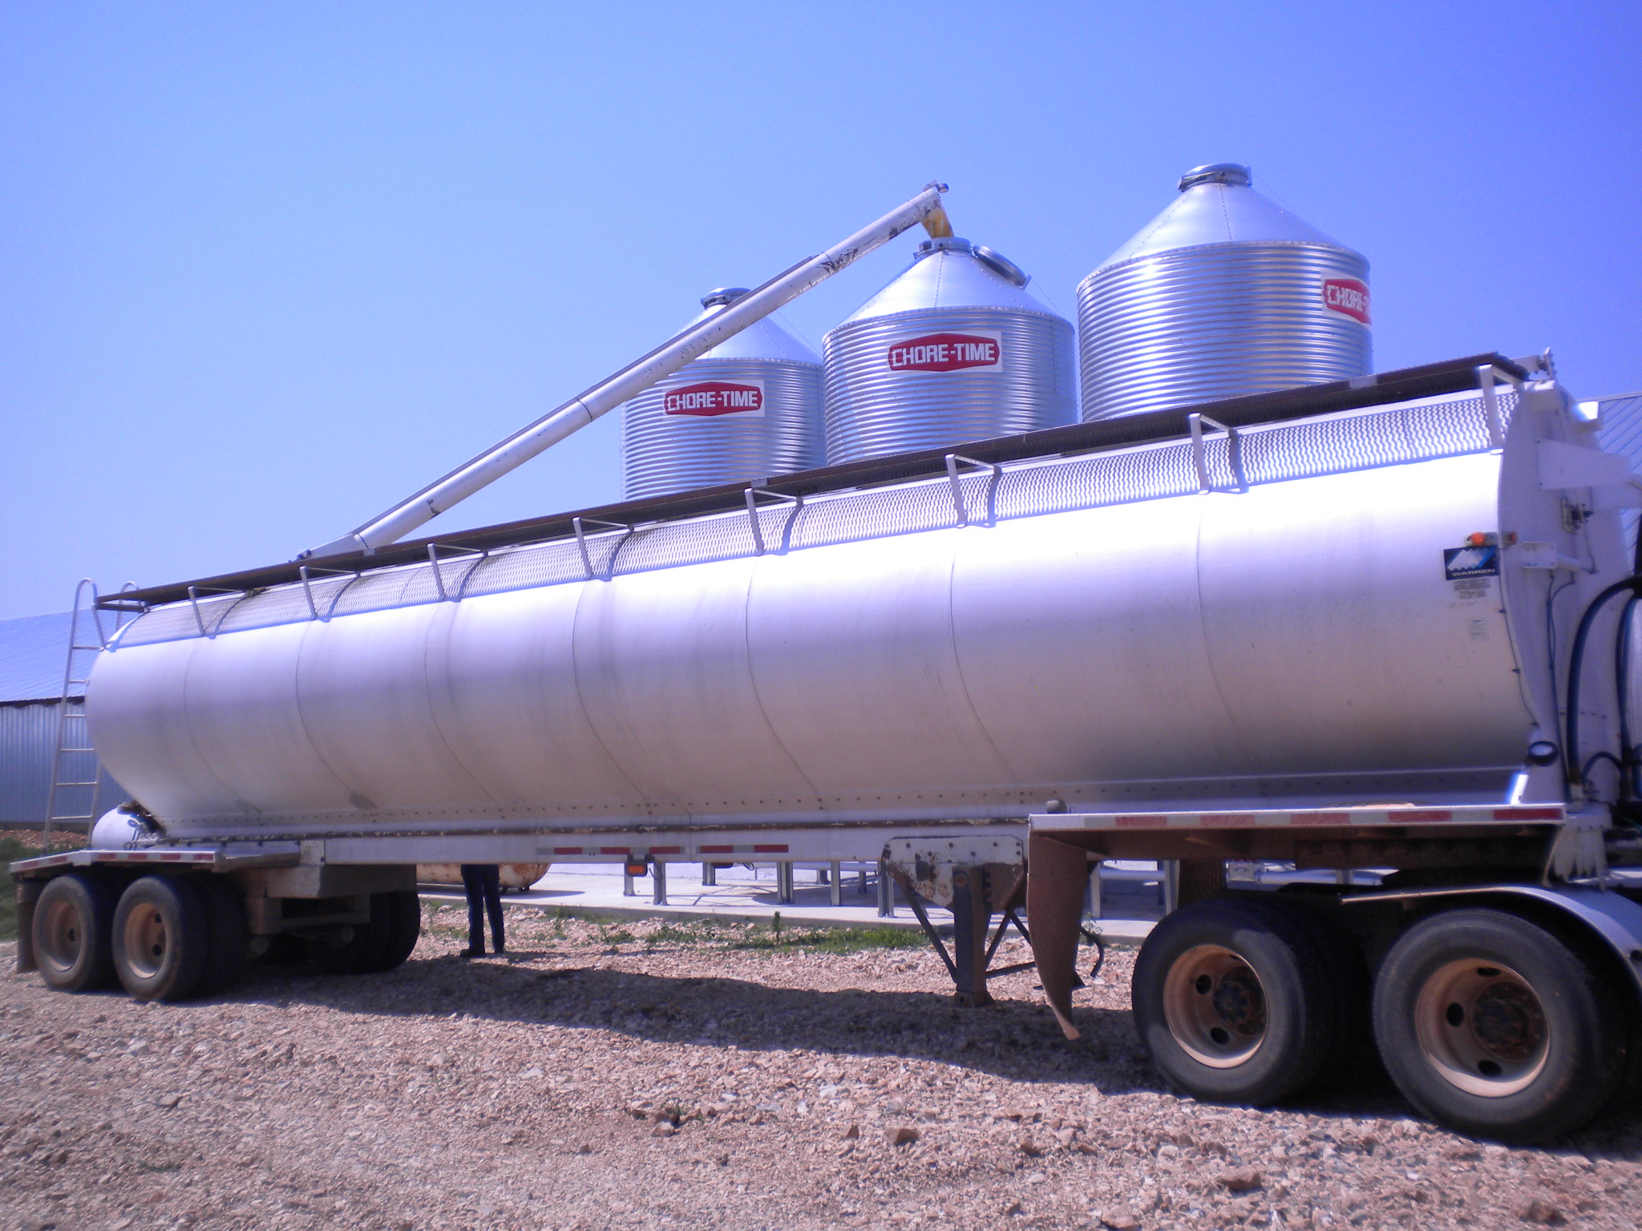
Site Selection
80,000- 6 pound birds will consume ~1,000,000 pounds of feed
    At ~30,000 pounds per load, ~33 loads

Slide 7
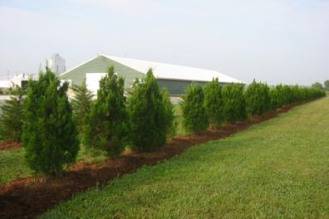
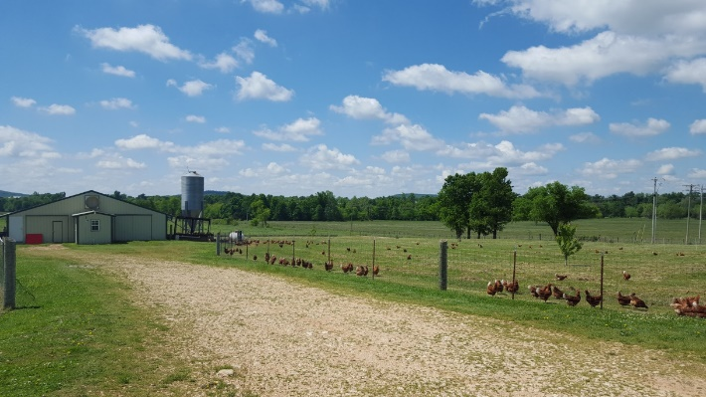
Site Selection
Evaluate proximity to existing poultry production or animal confinement farms
  ½ mile or further is ideal
  Shelter belt to minimize airborne contaminants helpful
What other poultry production is in the area?
  Turkeys
  Breeders
  Layers
  Broilers
  Backyard flocks
Confined or free range

Slide 8
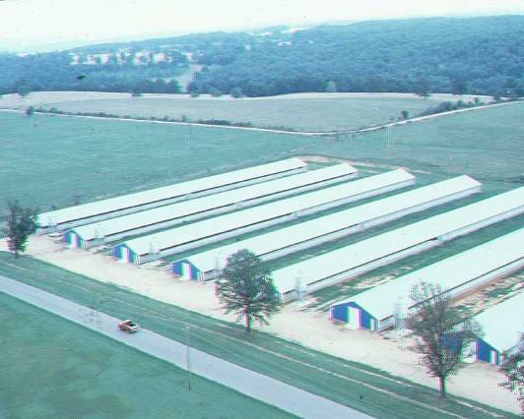
Site Selection
East-west orientation of houses-traditionally preferred
  Minimizes direct sun early/late in day on a full wall
    Reduces heating of barn in summer
    Southern exposure in winter helps warm barn
Solid side wall housing makes this less critical but this orientation should still be considered when possible

Slide 9
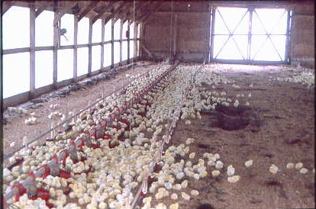
Traditional Open Sided Housing
Notes:
Starting chicks:
On floor as day olds. Barriers moved to allow for growth. Placed on litter to develop immunity to coccidia while still protected by maternal Abs.
0-3weeks

Slide 10
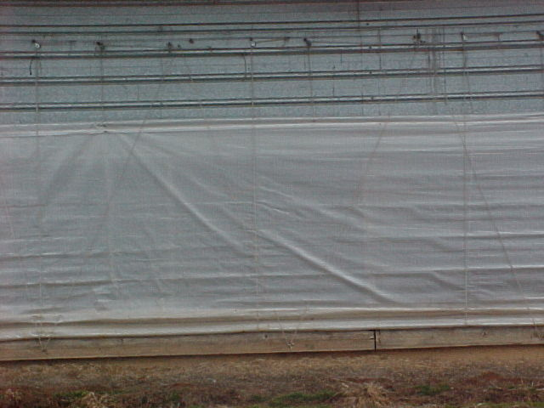
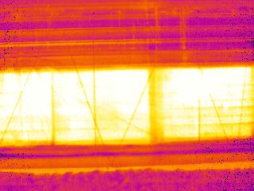

65.8ºF
View from outside on cold day
Curtain sided houses-
Temperature control vulnerable to sun and wind

Slide 11
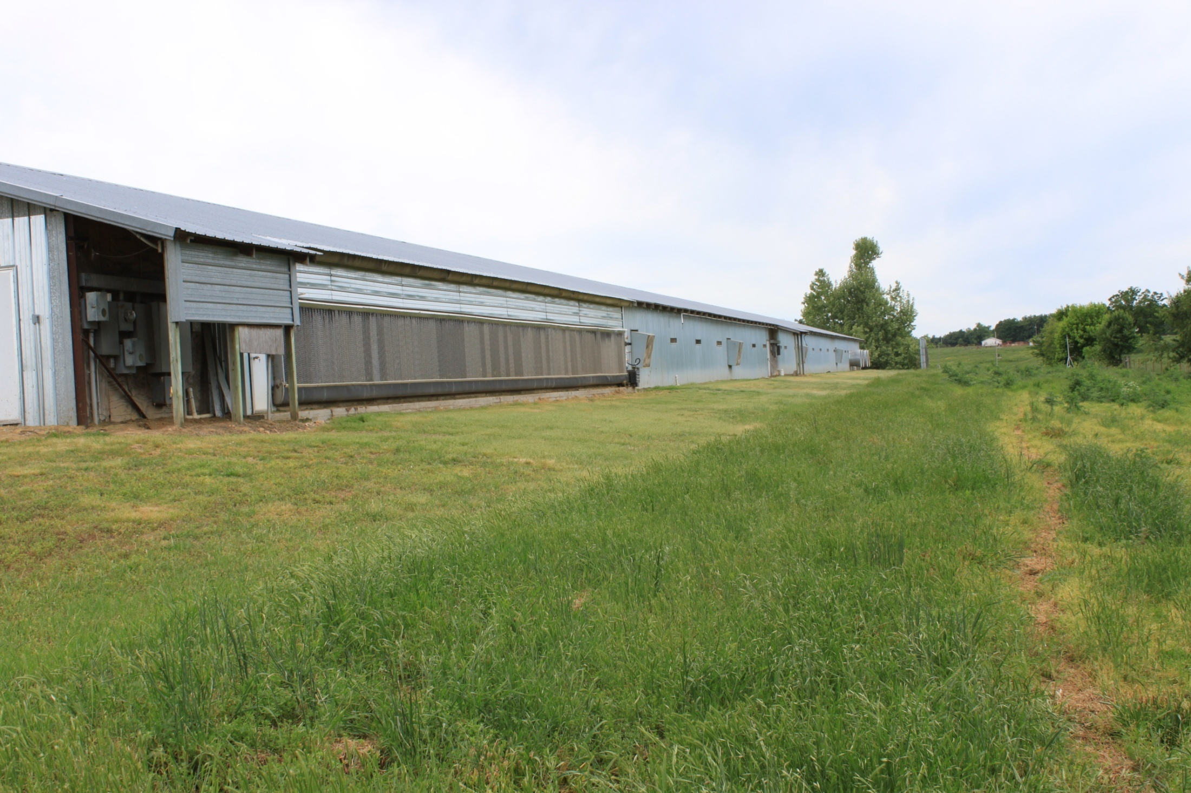
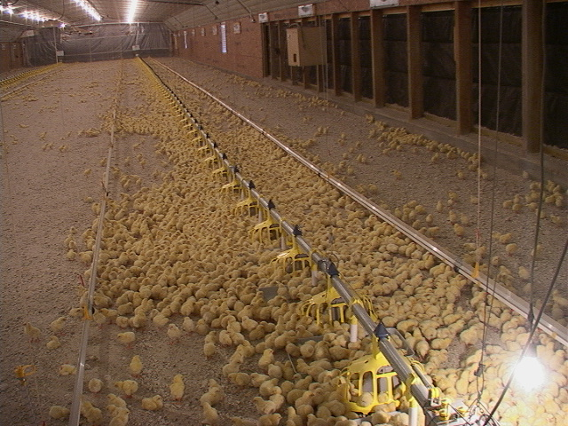
Solid side wall house much like
a residential home and can provide
the perfect environment no matter
what the outside weather conditions
Walls-R16
Drop ceiling –R26

Slide 12
Site Selection
Do you have enough land to expand, if desired?
Will there be proper drainage?
  Around roads
  Around houses

Slide 13
Property Setbacks and Easements
Setbacks from property lines, frontage roads, etc. can vary.
Research the requirements
  County
  State
  Poultry company
Acquire and keep any/all documentation stating required setbacks
Do not rely on word of mouth or suggestions- Do your homework and document!

Slide 14

Neighbors
Who are neighbors?
How close are they?
Do you currently have good relationships with the neighbors?
Do they have a garden? If yes, offer them free litter.
Can a wind block or shelter belt be planted to limit odors and visibility of farm?
  “If you can’t see it, it doesn’t smell as bad”

Slide 15
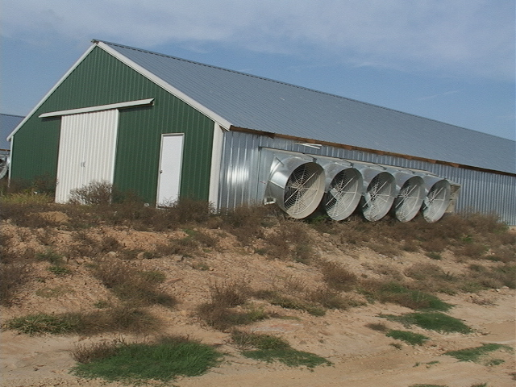
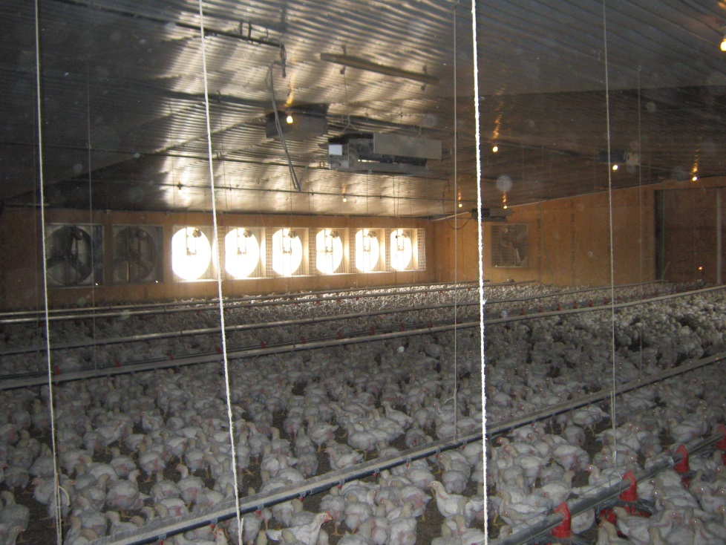
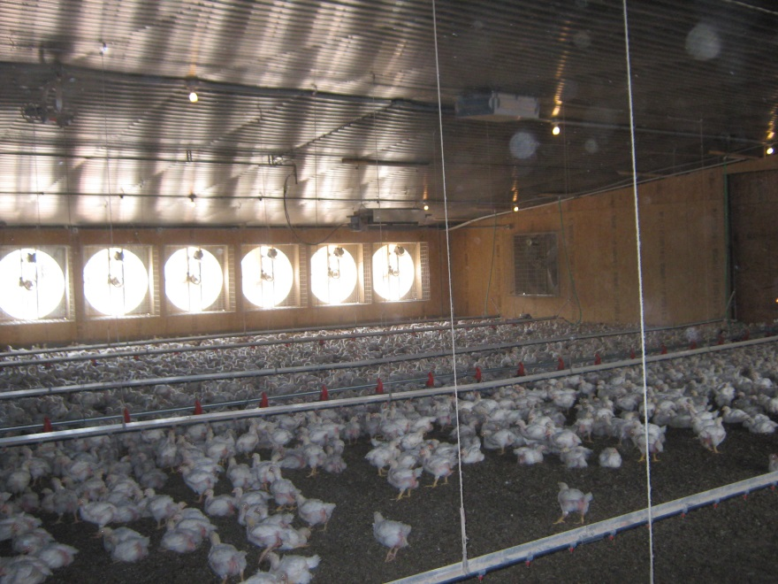
Neighbor consideration
Understand and comply with distance requirements to existing dwellings and property lines
If possible, orient fan exhaust so that it blows away from neighbors

Slide 16
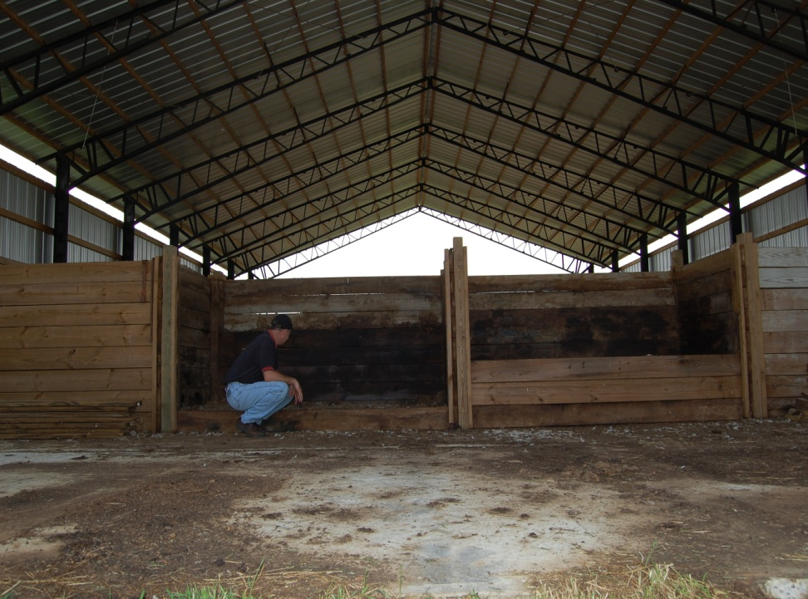
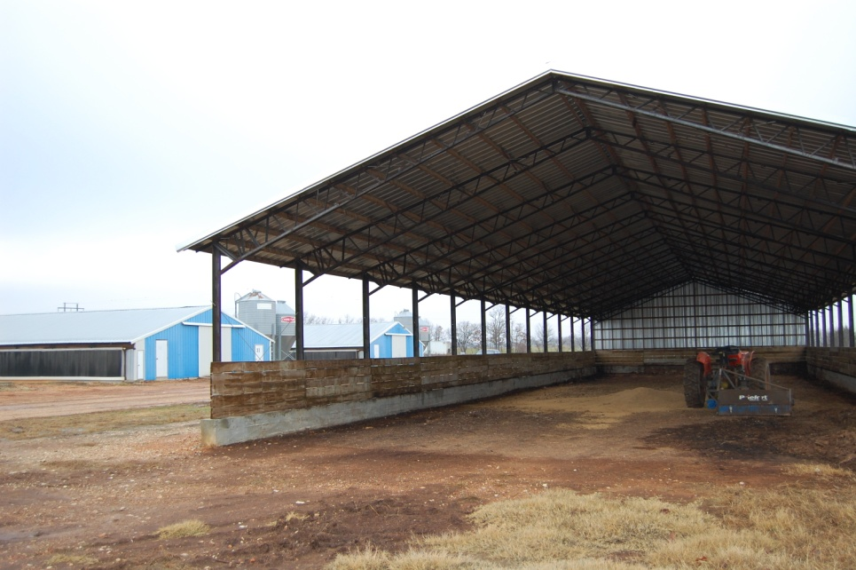
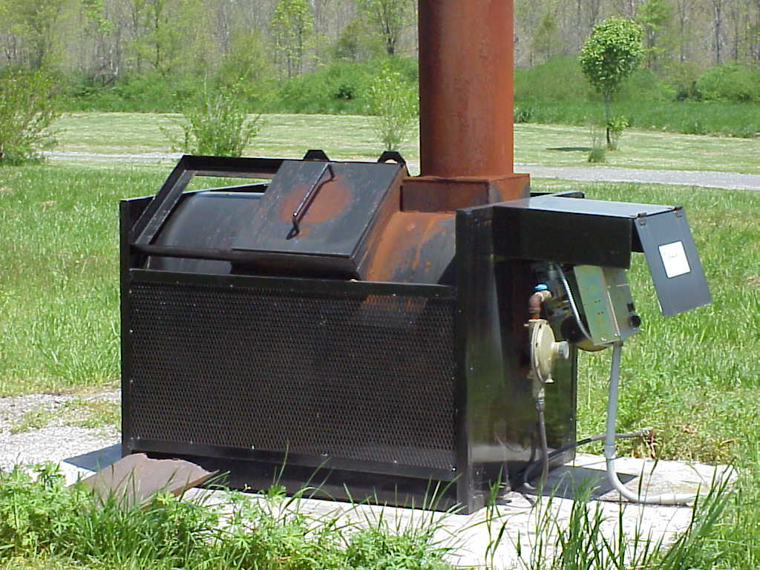
Neighbor Consideration
Consider location of litter storage barn(s) or compost building
If incinerator will be used for mortality, consider prevailing winds

Slide 17
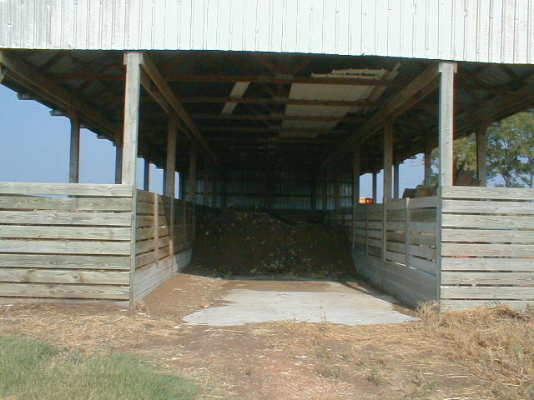
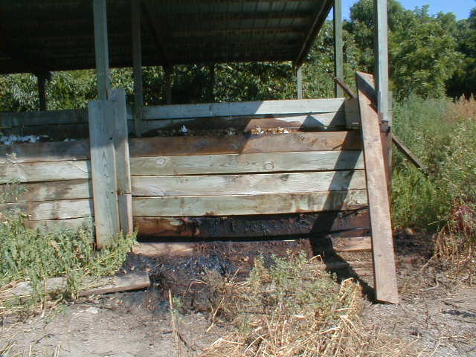
Sanitary Mortality Disposal
Crucial for Good Neighbor Policy
Improper management
of compost bins leads to
unpleasant odors-poor
neighbor relations

Slide 18
Disgruntled Neighbors = Lawsuits
Class-action lawsuit by homeowners in Morrison, Tenn., has been filed against seven defendants, including Tyson, in September 2009. The residents are angered about the odor emitted from the 10 house chicken facility that houses 400,000 birds.
The suit contends the plant generates “noxious gases, smoke, dust, fumes and odors” that nauseate neighbors and force them to stay indoors away from the stench.
In all, 65 residents were part of the class-action lawsuit which was settled by private treaty.

Slide 19
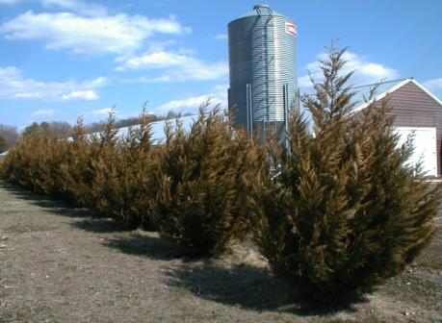
Vegetative buffer
Creates positive farm image
Landscape appearance and increases property value
Blocks view of houses, waste facilities and farm activities
Reduces odor, dust, feathers, noise, etc.
Out of site, out of mind!
Attractive farms have less odor

Slide 20
Goals of Vegetative Buffer (VB)
1.Visual screen
2.Windbreak + Shade
3.Vegetative filter
4. Biosecurity
Notes:
These plantings have 3 major objectives and must be designed to best meet these goals

Slide 21
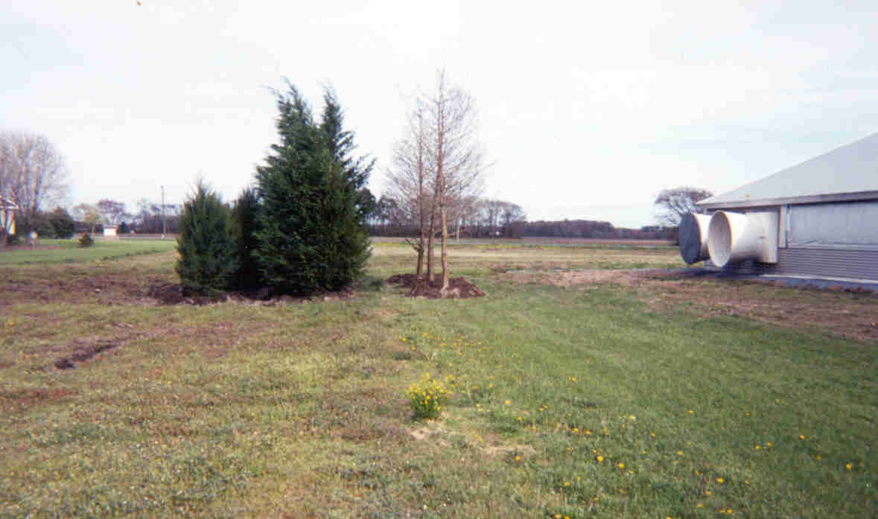
Vegetative buffer
Vegetative buffer near exhaust fans can reduce dust, ammonia and odor (Malone, 2007)
30’
8’
10’
Bald cypress 16 ft high
Leyland cypress 14 ft
Red cedar 8 ft high
Notes:
Plume distance is 10 times fan diameter. Plant trees at maximum plume distance.

Slide 22
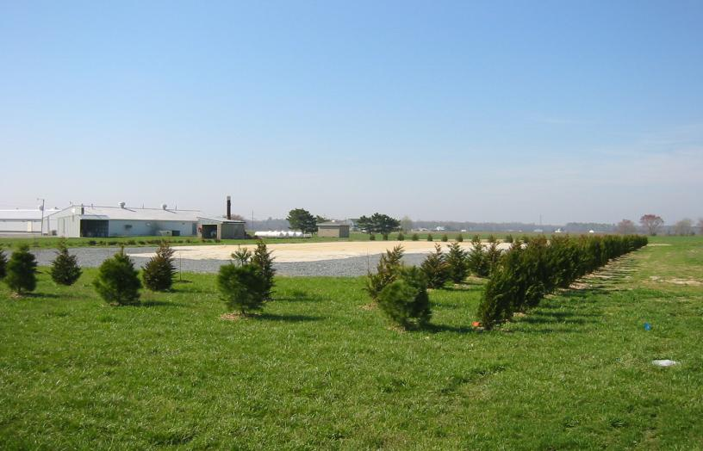
Vegetative buffer
Best to design and implement BEFORE building houses!
Notes:
Plume distance is 10 times fan diameter. Plant trees at maximum plume distance.

Slide 23
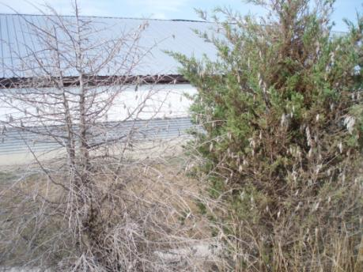
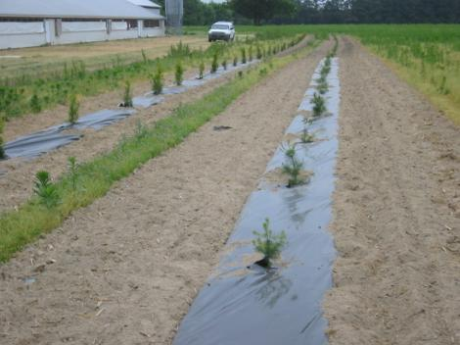
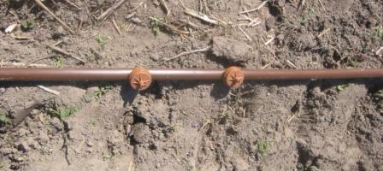
Vegetative buffer
Maintenance and care essential
Weed Control
Insects
Irrigation
Notes:
Plume distance is 10 times fan diameter. Plant trees at maximum plume distance.

Slide 24
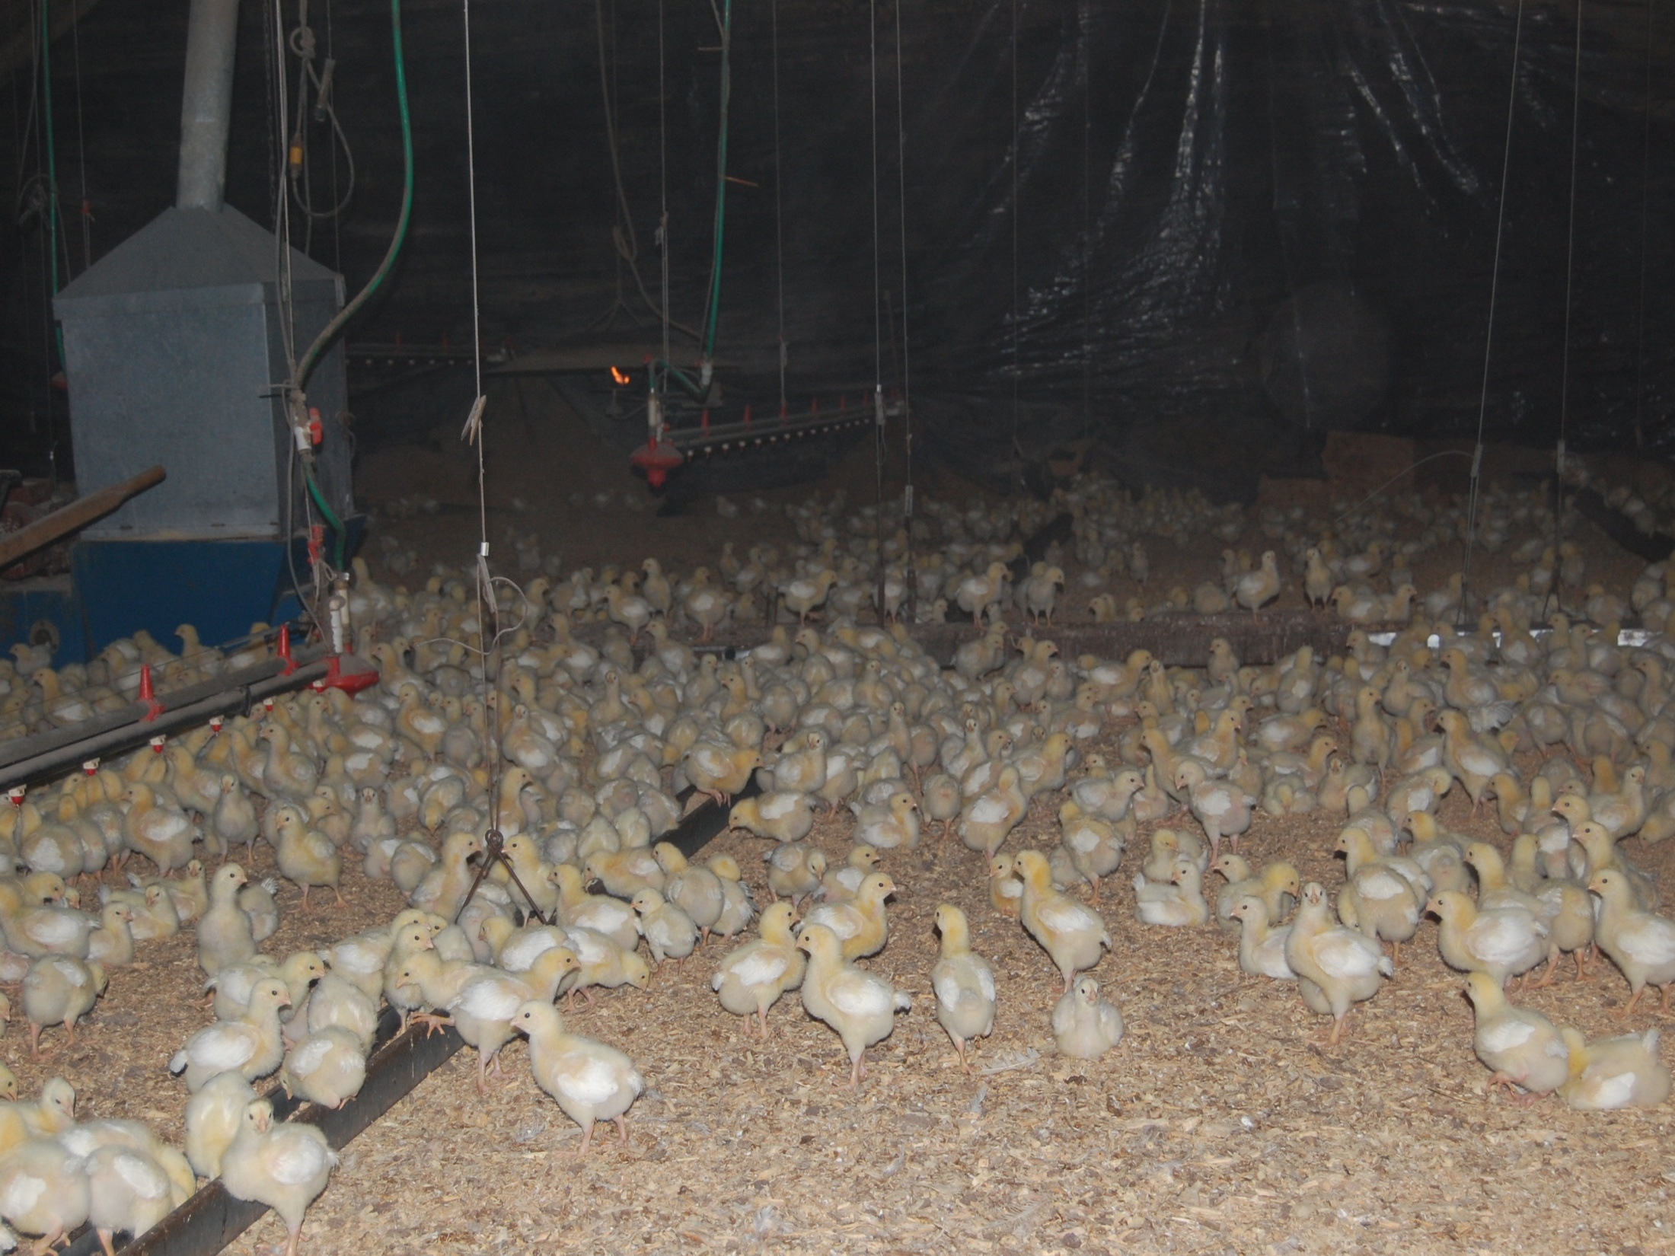
Manure Management
Properly ventilated poultry barns results in dry litter
  Less pathogens
  Less ammonia
  Less odor
  Less flies
Notes:
Plume distance is 10 times fan diameter. Plant trees at maximum plume distance.

Slide 25
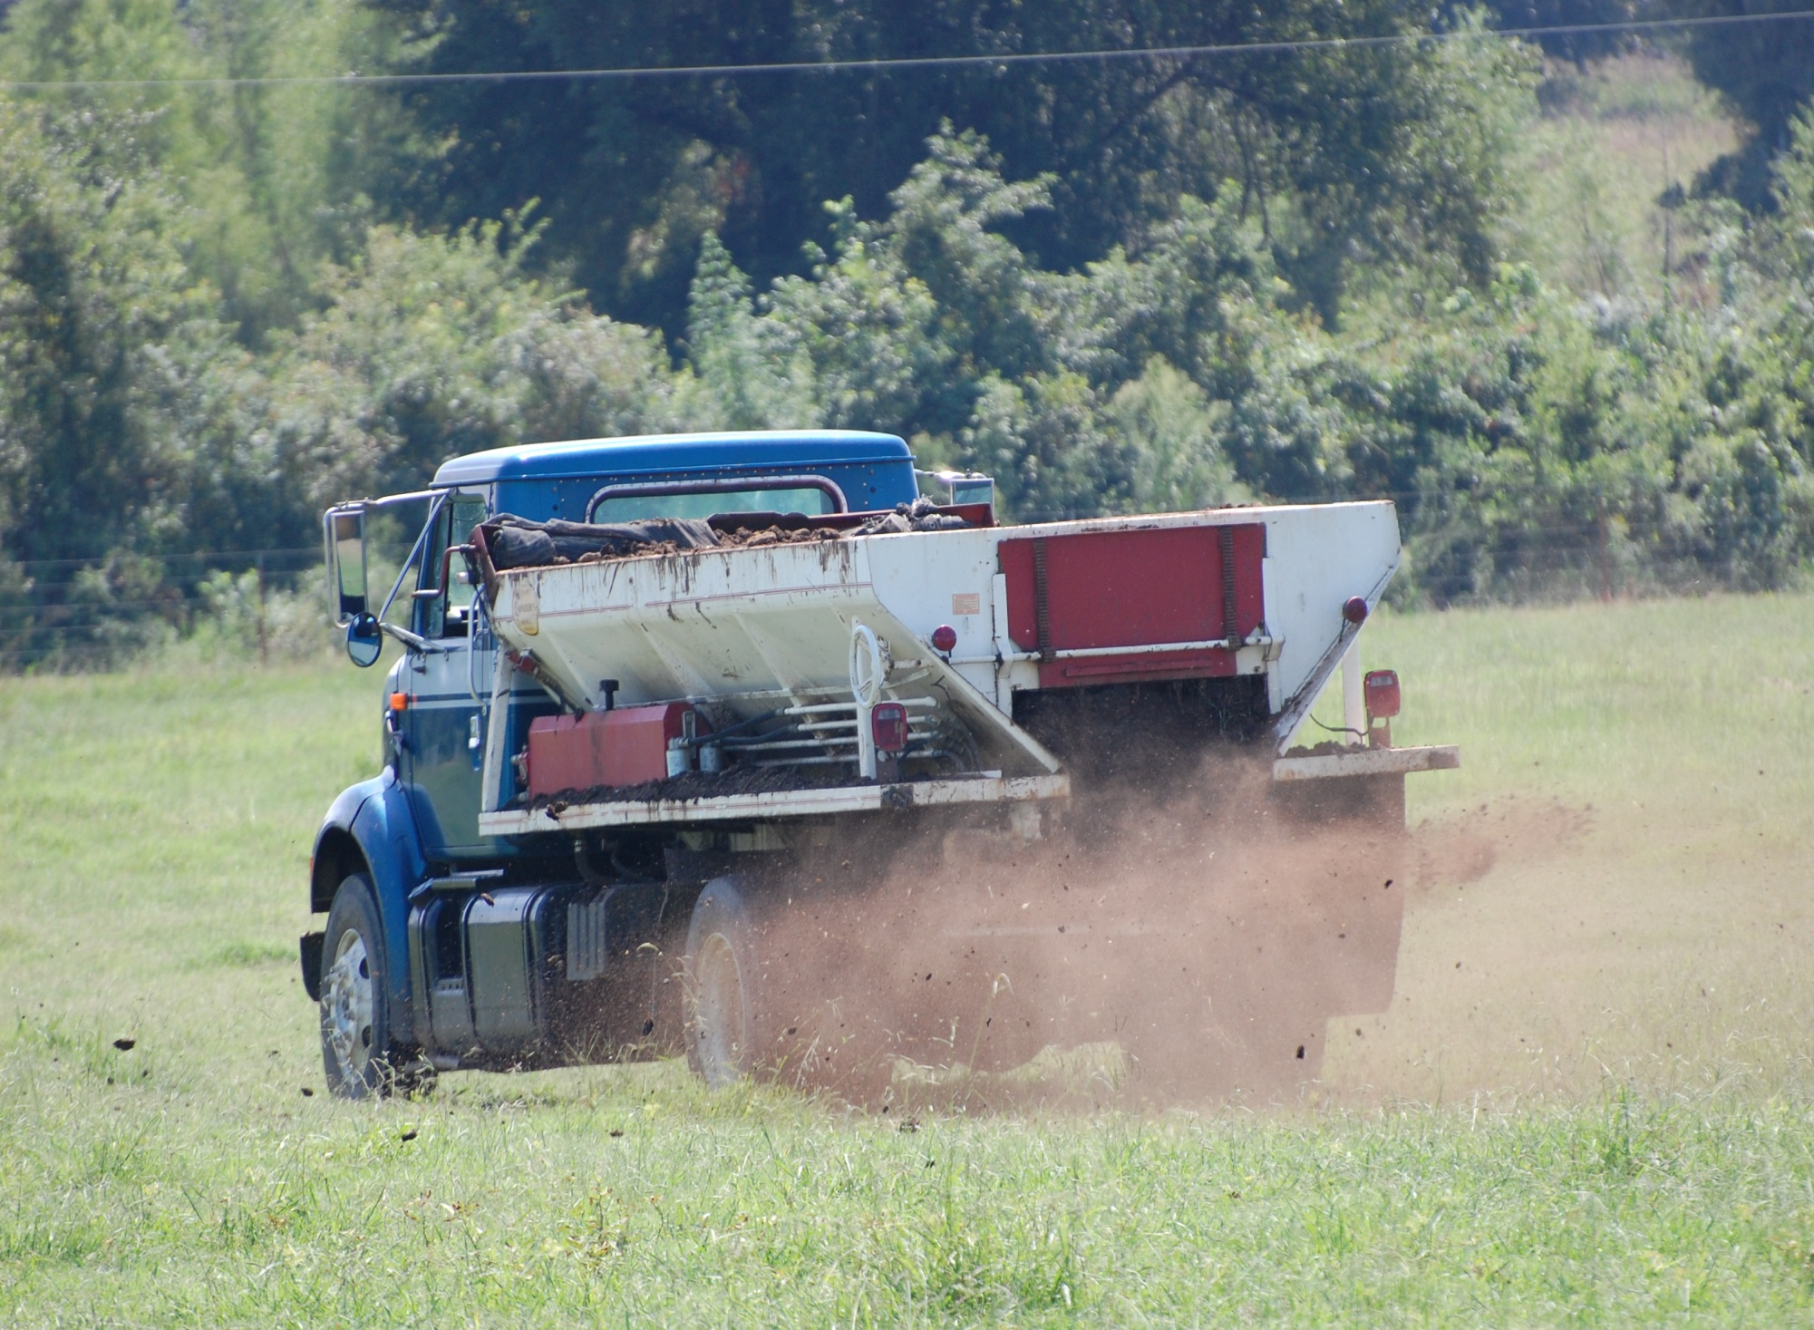
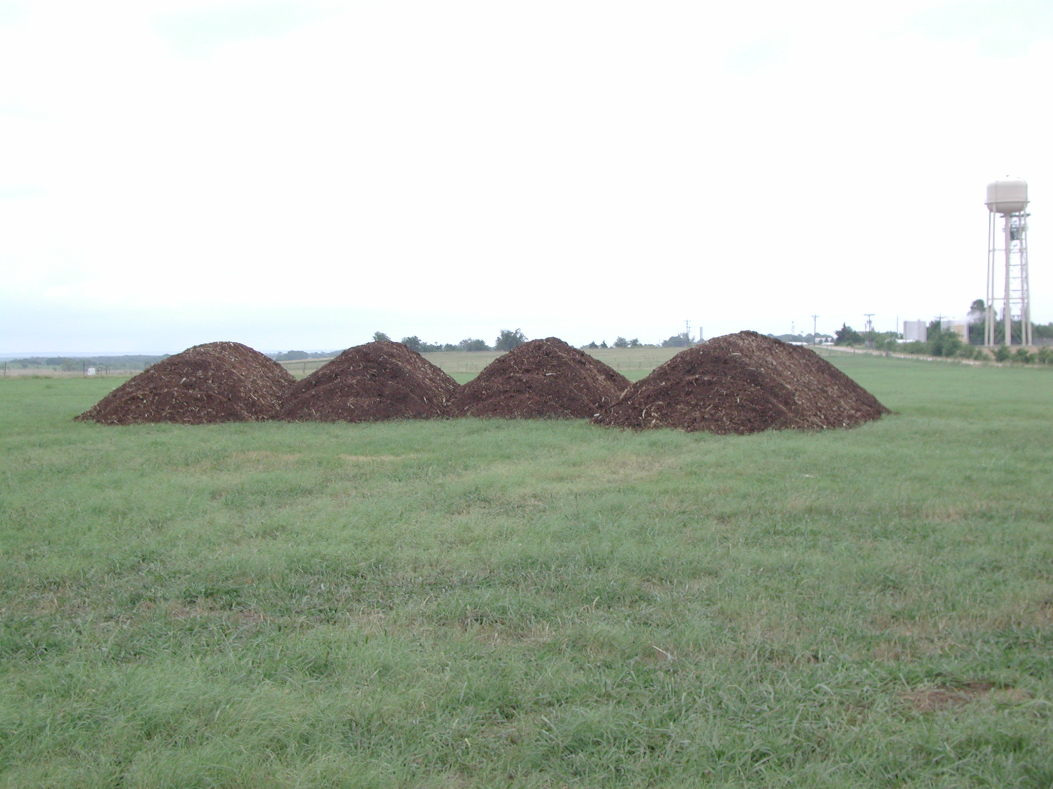
Manure Management
Consider land mass required
  Ex: ~150 tons litter/broiler house; 2 tons/acre
Equipment required to spread
Avoid windy days if possible
Be mindful of wind direction and neighbors
Applying before a light rain event can reduce ammonia emissions from field
Consider crops that utilize both N and P
  Ex: Legume crops may not be ideal
Notes:
Plume distance is 10 times fan diameter. Plant trees at maximum plume distance.

Slide 26
Roads
Must provide year around, all weather access to the farm
Consider route of construction equipment, concrete trucks, chick truck, feed trucks, live haul, etc.
Avoid sharp corners, narrow gates, and neighbor’s mailboxes!
Consider overhead clearance of trees and power lines

Slide 27
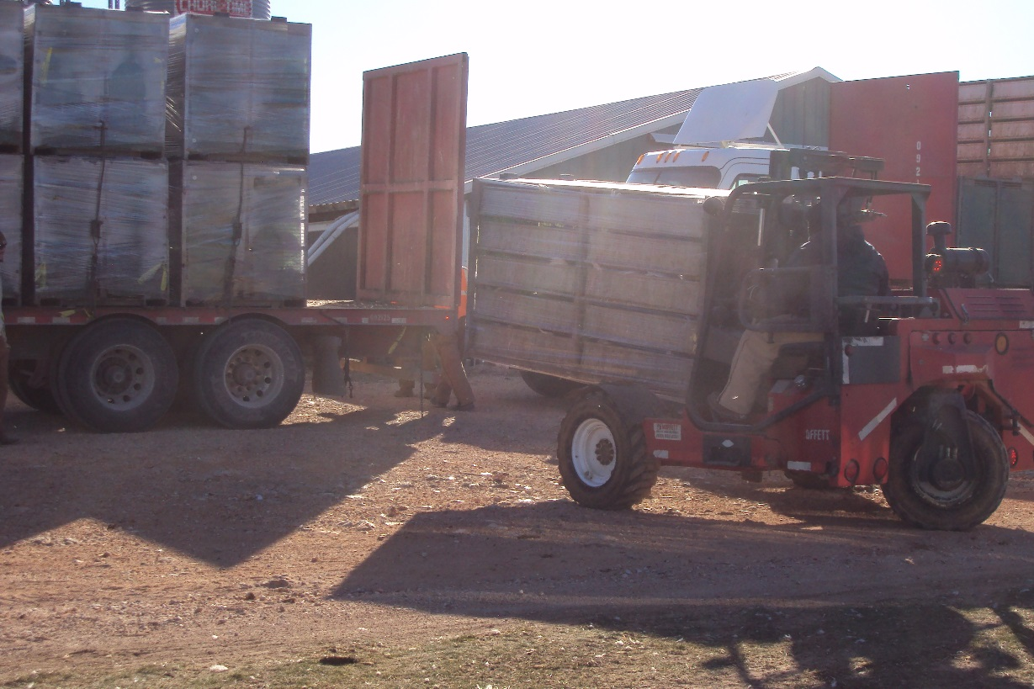
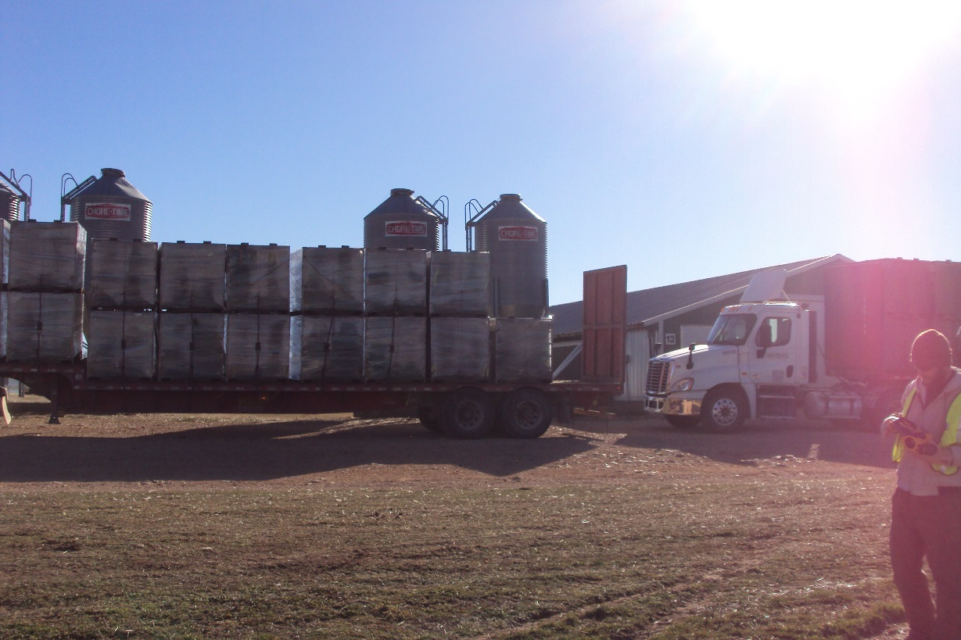
On-Farm Safe Roads are Essential
Live haul trucks-Unique load
Loadout modules are
stacked 2 high-this means
the truck load is top heavy.
Un-level road surfaces
greatly increase the risk of trucks
turning over

Slide 28
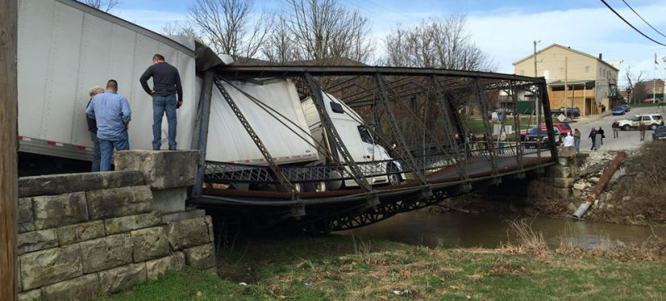
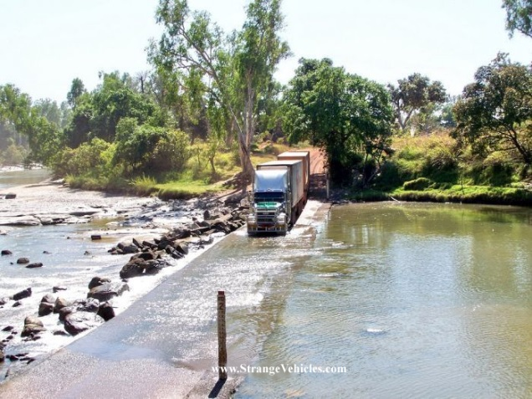
Bridges
If possible, consider routes that do not require use of low water bridges and/or low weight bridges for concrete trucks, etc.
If bridges cannot be avoided:
  Are they load rated for farm traffic?
  Are they prone to flooding?

Slide 29
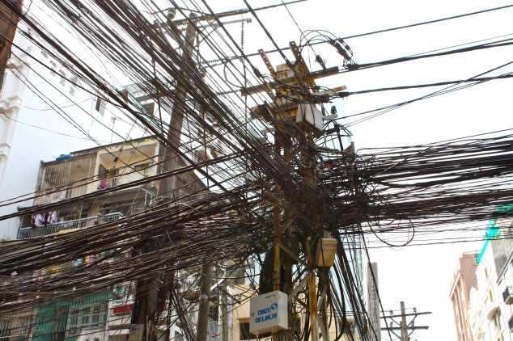
Utilities
Consider proximity & access
  Primary electrical
  Natural gas
  Rural water
Talk with utility providers early to discuss all fees, service rates, etc. to the farm

Slide 30
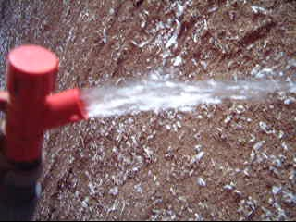
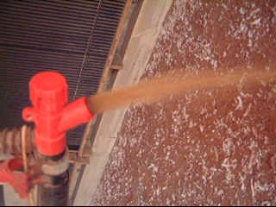
Water Supply
Quantity and Quality are Essential
Investigate water quality and volume availability in the area
  50 x 600 house size- Plan for a minimum of 20 gpm/house during peak demand

Slide 31
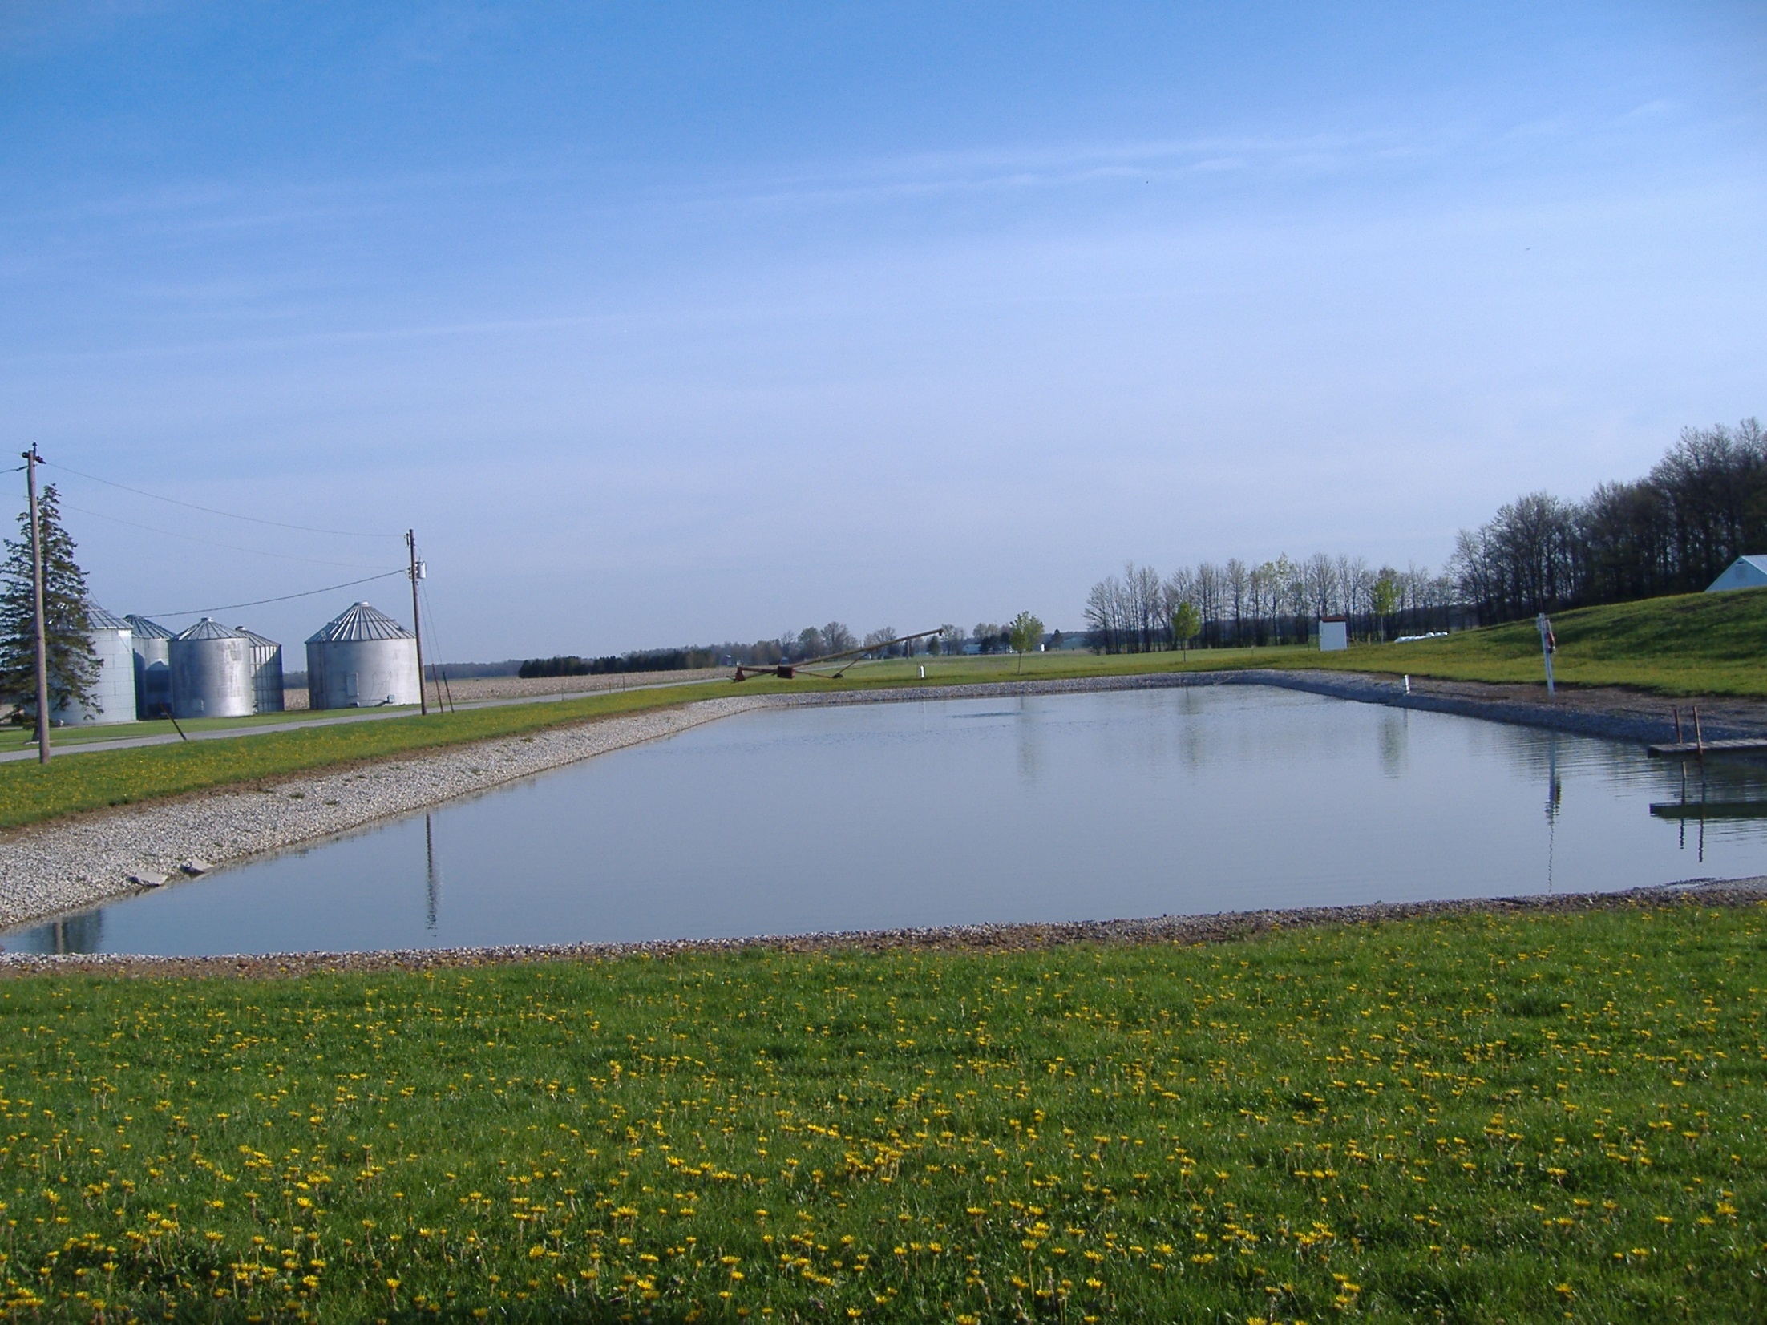
Water Supplies Are Dynamic
Can change from season to season
  Droughts and floods
  Agriculture, industry and septic systems
    Oil drilling, chemical plants or chemical storage, etc. etc.
  Well depth and placement
  Rock and soil it passes through
  Usage level
Surface water supplies like ponds most vulnerable
There will always be something dissolved in water
  The question is: what’s in your water today?

Slide 32
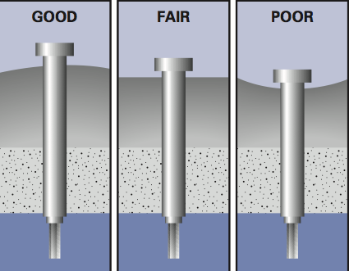
Well Head Design and Maintenance
Preventing Problems
• Install a locking well cap or sanitary seal to prevent unauthorized use of, or entry into, the well
• Do not mix or use pesticides, fertilizers, herbicides, degreasers, fuels, and other pollutants near the well
• Never dispose of wastes in dry wells or in abandoned wells
• Pump and inspect septic systems as often as recommended by your local health department
• Never dispose of hazardous materials in a septic system
• Take care in working or mowing around your well
Source: EPA 816-K-02-003, January 2002

Slide 33
Analyze water for mineral content and identify challenges some challenges must be addressed

Slide 34
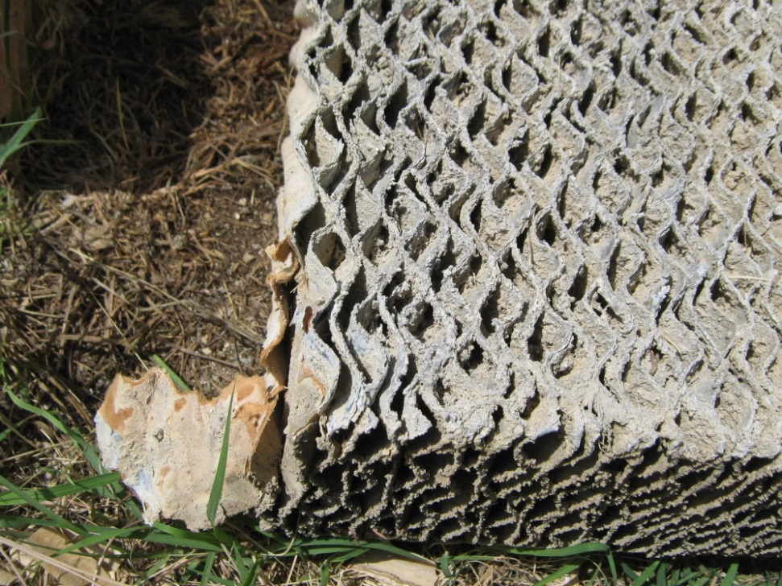
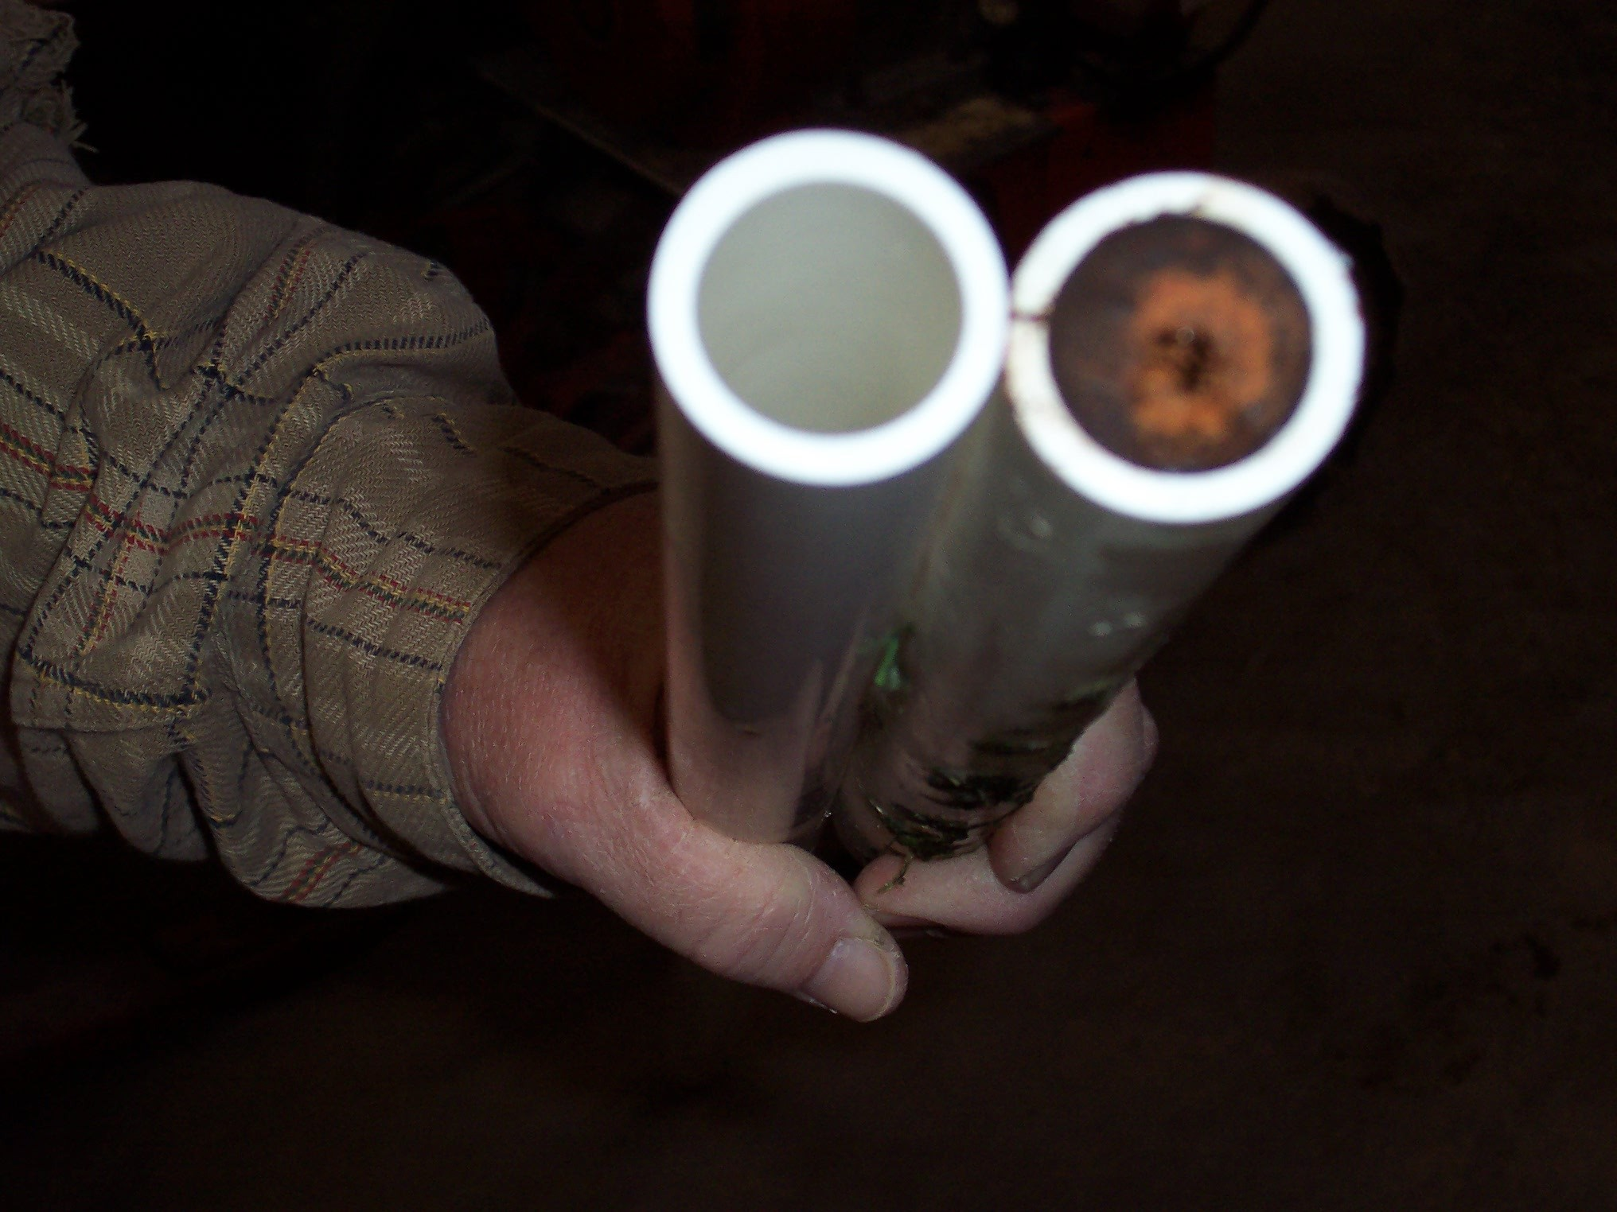
Hardness-Challenges
Cool Cells
  Air flow can be restricted due to mineral build-up
Plumbing
  Can restrict volume over time
Treatment options
  Water softener
  Polyphosphate-expensive
  Acidify water

Slide 35
Final Consideration-
Not a good idea to get creative with a new poultry farm
Encourage new producers to stick with the tried and true
  Dirt work
  Construction
  Equipment
  May seem like a money savings idea to go with your brother in law who does dirt work on the side or that new equipment a vendor wants to give you a great deal on.
  Does your brother-in-law understand poultry house construction?
  Will there be a dealer in the area to service that equipment
  Does anyone know if that equipment is good quality?
  Too many times- cutting corners costs more than it saves

