Slide 1
Livestock and Poultry Expansion: Critical Issues for Discussion with Farmers & Communities
Preparations for today:
Open Chat Box – access to handouts and ask questions.
Mute microphone during presentation, unmute during Q&A
View archived presentations, obtain handouts: http://water.unl.edu/livestock-poultry-expansion-critical-issues-discussion-farmers-and-communities and click on Agenda
Join us for our next webinar on Monday, July 25, 2016 (Noon CDT)
Siting Facilities for Biosecurity
Sheila Purdum: Into to AI and other siting considerations
Renee Hancock: Planning for Mortality

Slide 2
Site Visit: Applying Principles to the Farm
Hosted by Bill Bevans, farmer & poultry producer (near Lincoln)
Hear from Bill about issues important to him. Use maps and aerial photos to evaluate alternative sites.
Meet from 1 to 3 PM
Date to be determined by Doodlehttp://doodle.com/poll/h5429zz799trgnr8

Slide 3
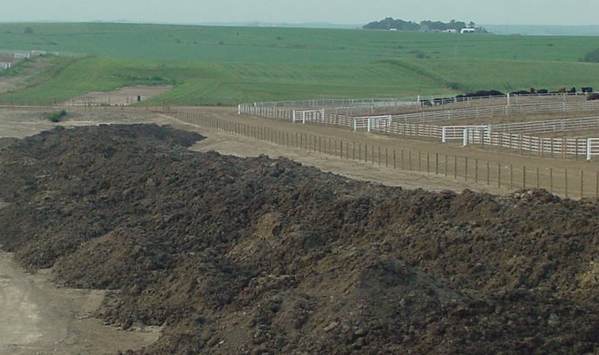
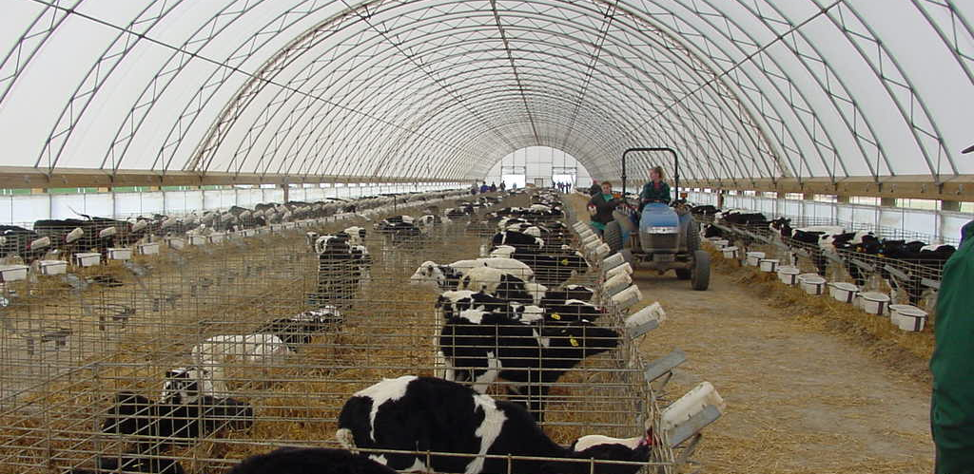
Site Considerations for Managing Manure Nutrients
Richard K. Koelsch, Bio. Systems Engr. and Animal Science, University of Nebraska

Slide 4
My Purpose
What is our goal?
Two Questions to assist potential animal producer during planning process:
How much land will a grower need access?
Will buffer/setback expectations allow for manure application?

Slide 5
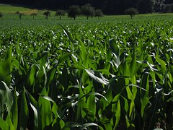
What Is Our Goal?
Recycle Nutrients and Carbon
Manure
Balancing field Imports with crop requirements:
Balance N annually.
Balance P annually, if practical, or over 3 to 5 year period
Limit Edge of Field Loss
Building soil carbon and pH
Crop
Fertilizer
X
Edge of Field Loss
Other N Sources

Slide 6
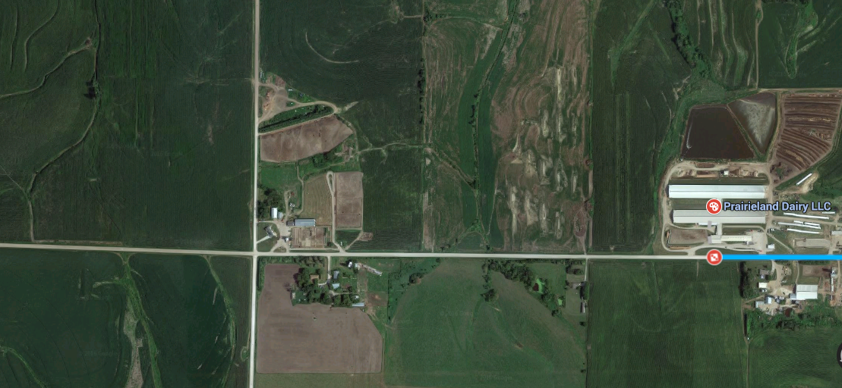
The Nebraska Advantage: The Opportunity to Recycle
Fertilizer & Feed
Integrated crop & livestock allows recycling of nutrients

Slide 7
Separating animals & feed has created ag’s most challenging water quality issues
?
Counties where Manure P is:
< Crop needs
Approaching
Crop Needs
> Crop Needs

Slide 8
How much land will animal facility need access?
Animals Excreted N/yr Excreted P₂O₅/yr
1,000 cow dairy 347,000 128,000
1,000 beef cattle 56,000 16,000
100,000 layers 125,000 87,000
100,000 broilers 71,000 52,000
1,000 finishing pigs 26,000 9,600

Slide 9
How much land will animal facility need access?
Animals Land for N* Land for P*
1,000 cow dairy 1,300 ac 2,100 ac
1,000 beef cattle 100 ac 270 ac (open lot)
130 ac 270 ac (barn)
100,000 layers 530 ac 1,400 ac
100,000 broilers 60 ac 810 ac
1,000 finishing pigs 110 ac 160 ac
* Applied to 200 bushel/ac corn

Slide 10
Four broiler barns – 176,000 birds capacity
Excreted
125,000 lb N /yr
91,000 lb P₂O₅/yr
Delivered to field
35,000 lb N/yr
87,000 lb P₂O₅/yr
Land Required:
110 acres for N
1,400 acres for P

Slide 11
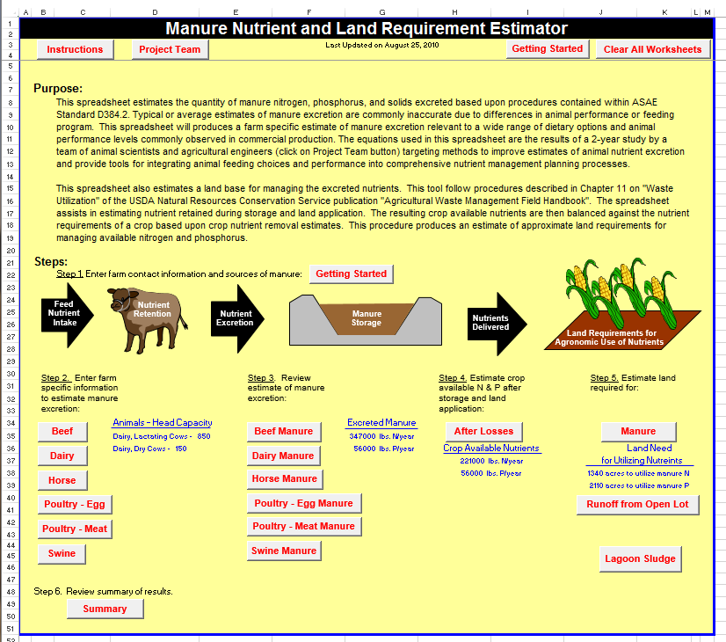
Go to “Software” web page http://water.unl.edu/manure/software#nutrient Look under “Nutrient Inventory”

Slide 12
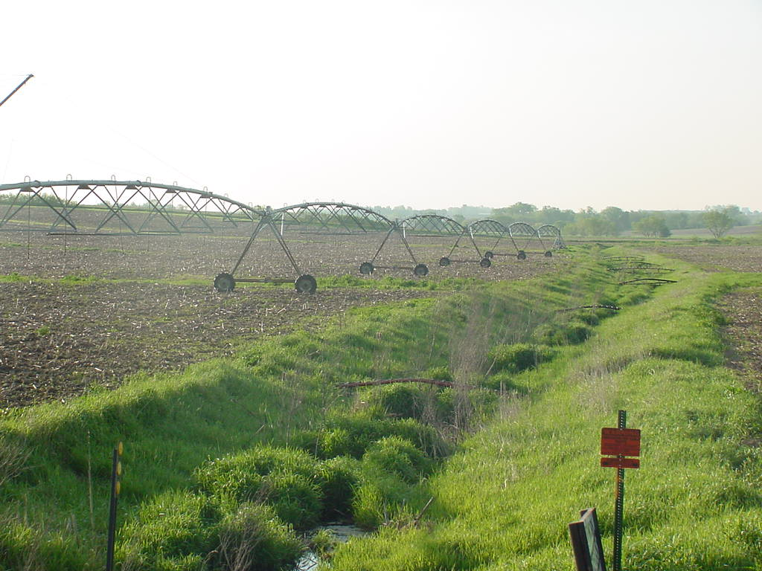
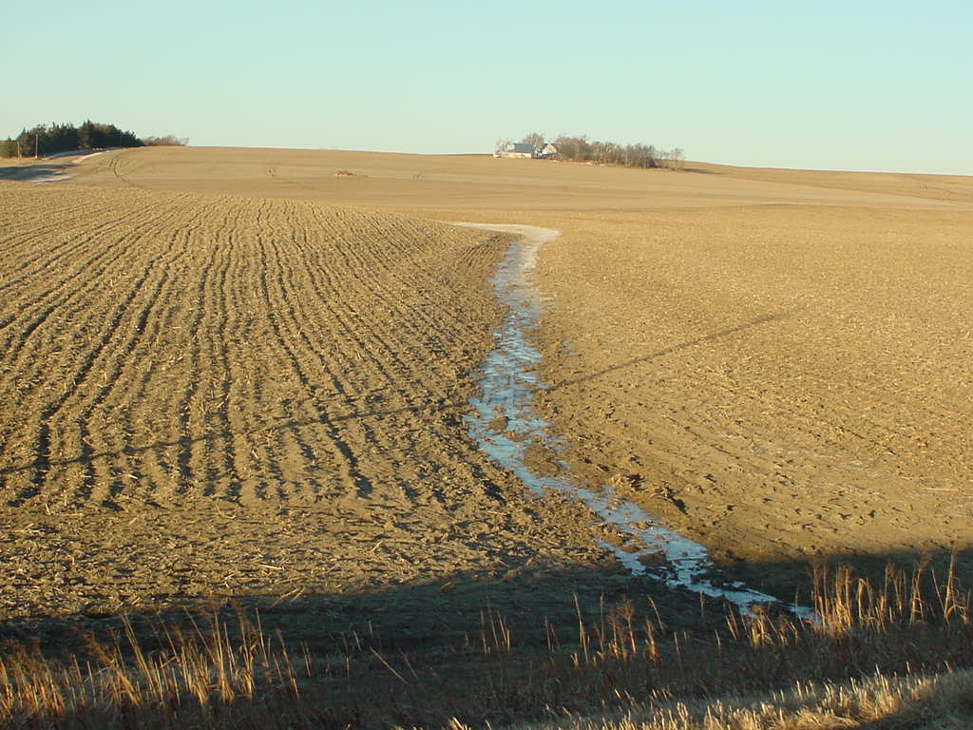
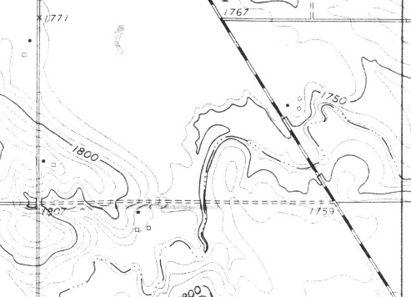
Buffers or Setbacks
Title 130: Manure is “not to be applied within 100’ of down-gradient surface waters, tile intakes, sinkholes, well heads, or other conduits to surface water”. 35 foot grassed buffer is option to 100 foot no application zone.
?
?

Slide 13
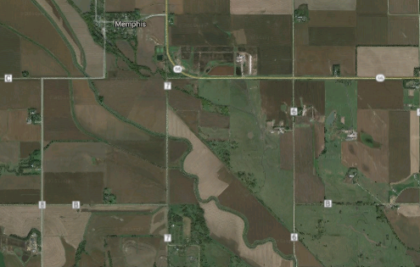
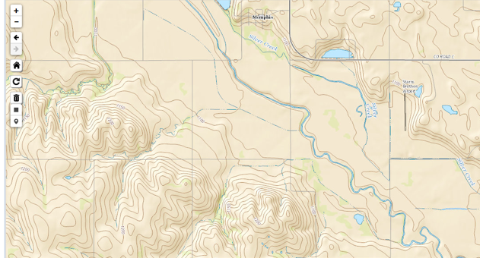
Setbacks & Grass Buffers Needed?
???

Slide 14
Take Home Message – N & P Exports
Our ability to recycle manure nutrients & carbon is a Nebraska’s advantage.
Help producer answer:
How many acres are needed to recycle N & P?
Will setback/buffer requirements eliminate some fields from consideration?

Slide 15
Questions & Comments
Richard K. Koelsch, University of Nebraska, rkoelsch1@unl.edu, 402/472-3935

Slide 16
What Principles Should Guide Nutrient Plans of the future?
Minimize environmental impact of nutrients
Satisfy public (& regulatory) expectations
Document farm’s sustainability?
Measurable metrics?
Efficient use of inputs?
Continuous improvement?
Communicate to consumer?

