Slide 1
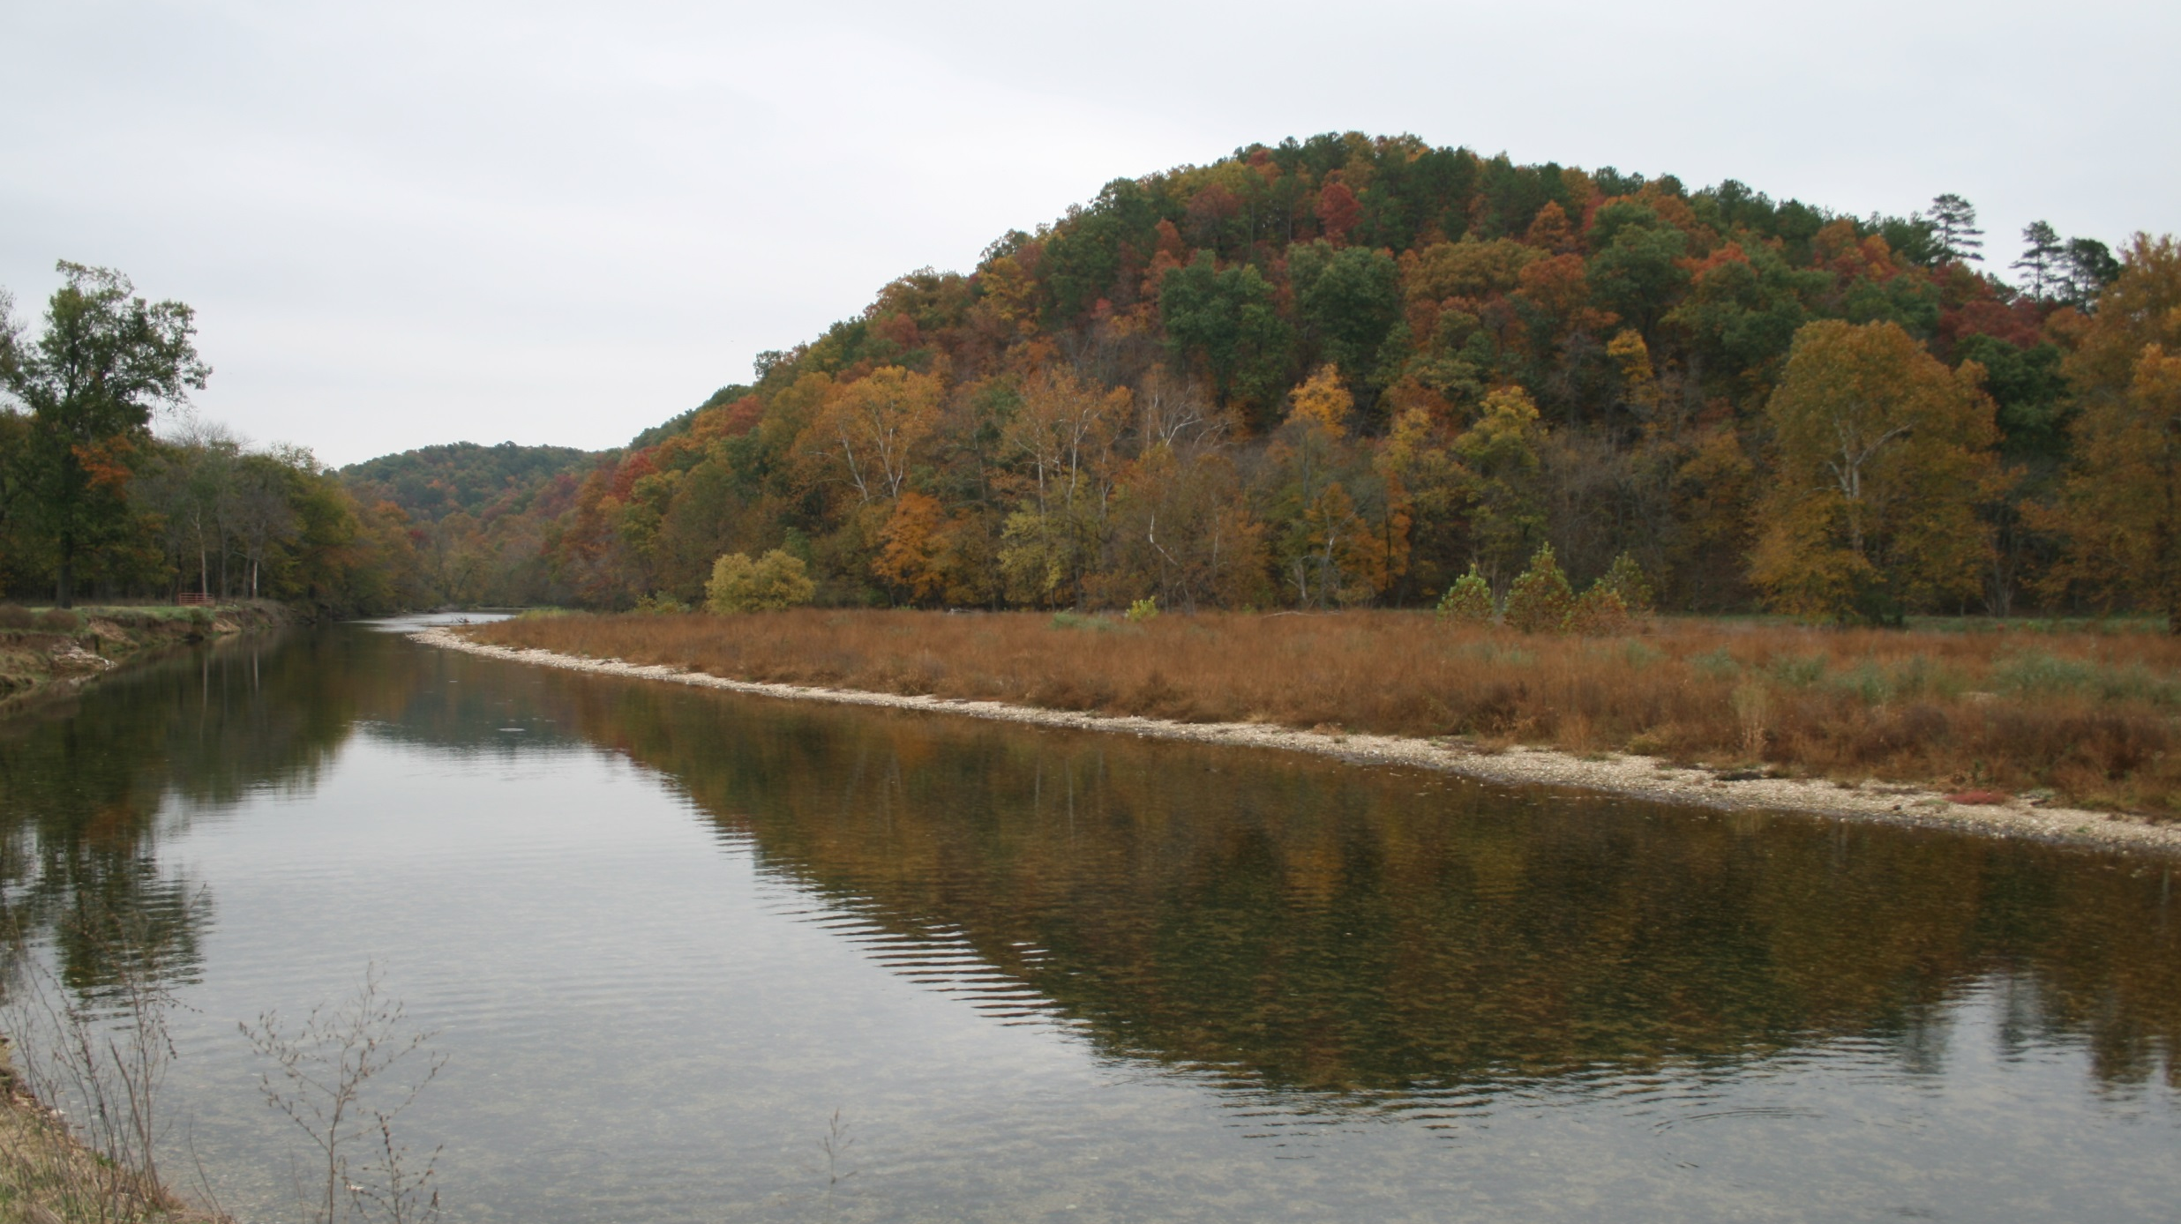
Water Quality Risks Associated with Poultry Production
Dr. Aaron Mittelstet
Assistant Professor
Biological Systems Engineering
University of Nebraska-Lincoln
July 22, 2016

Slide 2
Illinois River (IRW) and Eucha-Spavinaw Watersheds (ESW)

Slide 3
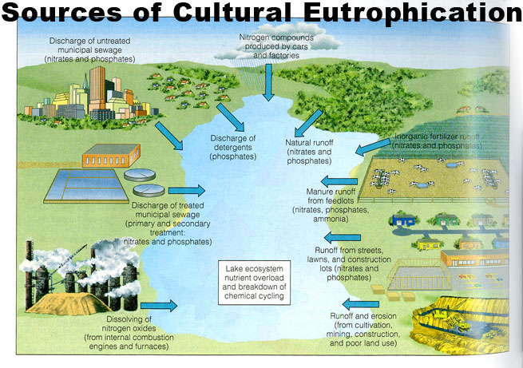
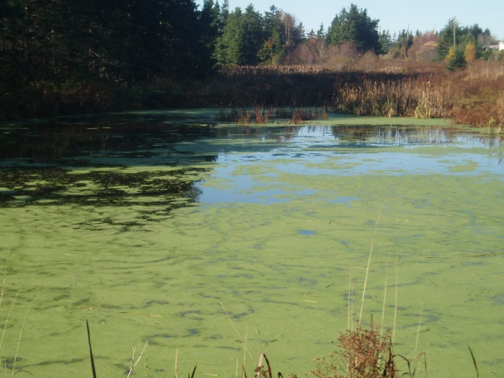
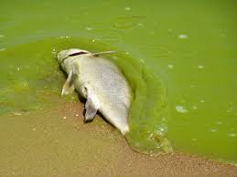
Water Quality Issues in the IRW and ESW
Streams and reservoirs eutrophic
Phosphorus usually limiting nutrient
Waterbodies on 303d list due to:
  Excessive phosphorus
  Dissolved oxygen
  Excessive chlorophyll-a
  Turbidity

Slide 4
Phosphorus Sources
Mittelstet and Storm, 2016
Watershed | # Poulty Houses | # Broilers yr⁻¹ | Poultry Litter (t)
Illinois River Eucha-Spavinaw Elkhorn River | 1,958 508 400 | 150,000,000 40,000,000 32,000,000 | 320,000 80,000 65,000

Slide 5
Legacy Phosphorus
Over 80% of all phosphorus added to the watershed is
stored in the soil, stream system or reservoir
IRW
Mittelstet and Storm, 2016

Slide 6
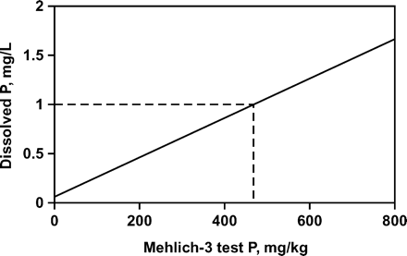
Soil Test Phosphorus

Slide 7
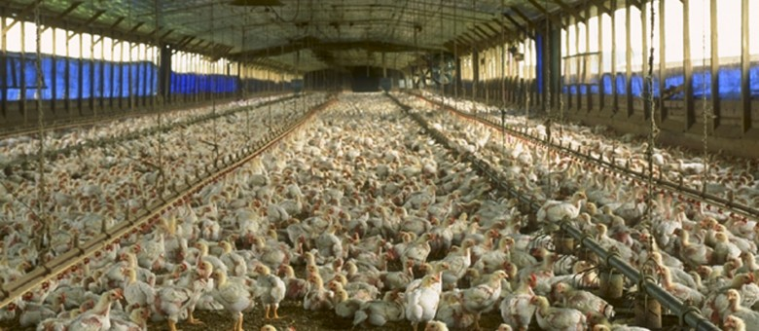
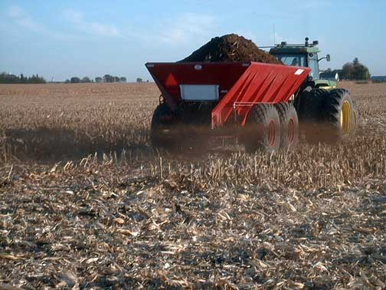
So, what can we do??
Require producers to develop Nutrient Management Plan
Annual testing for soil test phosphorus
Limit poultry litter application near waterbodies and when STP exceeds a pre-defined value

Slide 8
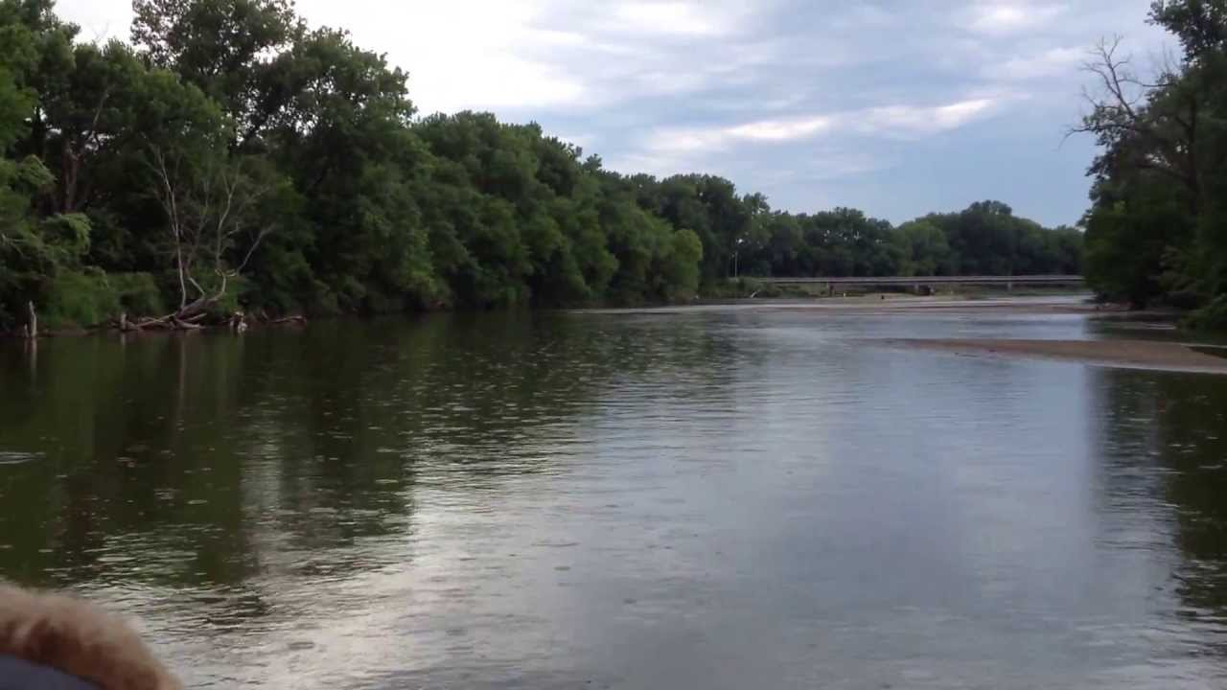
Aaron Mittelstet amittelstet2@unl.edu
402-472-1427

