Slide 1
Avian Flu – Update
Dr. Sheila E. Purdum
Extension Poultry Specialist
Professor, Animal Science, UNL

Slide 2
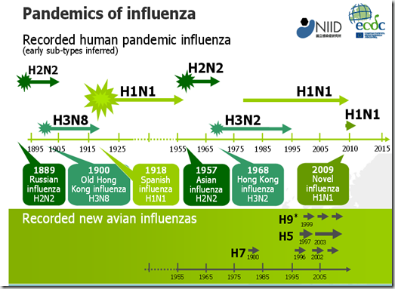

Slide 3
HPAI H5N2
“Largest loss of livestock due to a Foreign Animal Disease in the History of the United States”
Not the first introduction of Bird Flu in the U.S.

Slide 4
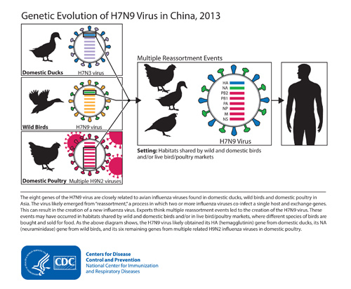
How do AI viruses mutate?

Slide 5
Movement of H5 clade 2.3.4.4

Slide 6
How is AI moving in the U.S.?
Eurasian H5 clade 2.3.4.4 is now present in North American flyways
•H5N8 appears well adapted to certain waterfowl species; no definitive means to predict how long it will remain in our flyways
•Asian and European studies have detected the H5 2.3.4.4 viruses in wild birds across Eurasian flyways and winter resting grounds

Slide 7
3 Major U.S. Poultry Sectors
Broiler – largest – production of broiler meat for consumption, (not eggs), geographically predominant in the U.S. Southeastern states
Turkeys – Minnesota is the largest state
Commercial Egg Production, largest egg producing state is Iowa (prior to 2015 break)
Egg production chickens are genetically quite different from meat production chickens

Slide 8
High Pathogenicity Avian Influenza (HPAI)
Over 40 million laying hens, constituting 11% of the U.S. layer flock
  30% decreased supply of egg products
    (hardest hit sector in U.S. Midwest region)
    Resulting in Changes in Restaurant Recipes and Use
Over 7.5 million turkeys (< 5% total market lost)

Slide 9
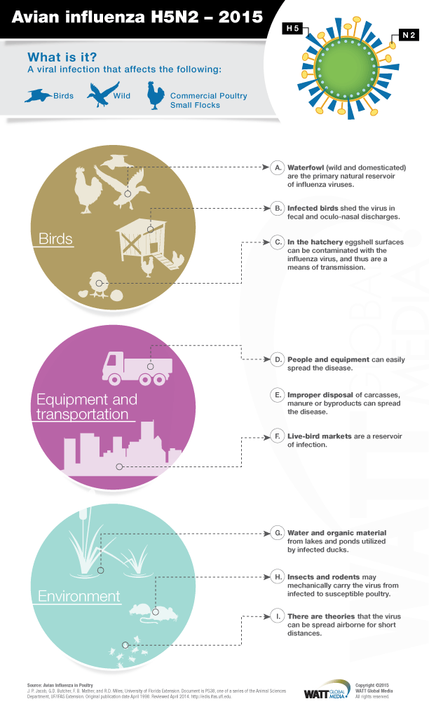

Slide 11
Different Serotypes of HPAI
H5N8, found in Pacific flyway 2015, waterfowl very well adapted to this serotype
H5N1 and H5N2, found in Mississippi and Missouri River Flyways
H5N2 primary serotype in Midwest Breaks, very high mortality in poultry flocks (>90%)
Virus mutates rapidly

Slide 12
Point Source vs. Lateral Spread
Minnesota Turkeys – Point Source contaminations by wild waterfowl sources
Iowa Layers – much lateral spread by human and vehicle vectors

Slide 13
Avian Influenza is Easy to Kill but highly Contagious
High temperatures kill this virus - > 95 for 48 hours
Simple strong disinfectants kill the virus – Chlorox solution
Exposure to UV light
So why did so many birds get this virus during Spring 2015?

Slide 14
Movement of Poultry Products
In order to move product in and out of control zones, within and outside of the state in which the plant is located, permits are needed. Companies work directly with their state and APHIS.
Example – Smart Chicken had several farms in Control Zones but none of their flocks broke with AI

Slide 15
Highest Risk Factors for Poultry Farmers
Located in a Infected Zone
High density of Corn Fields
Open water/lakes frequented by waterfowl

Slide 16
Biosecurity vs. Biocontainment
Biosecurity is protecting your farm, keeping all possible vectors of HPAI OUT!
Biocontainment occurs once you have HPAI in your facility, keeping it in and from spreading to your neighbors

Slide 17
Losers and Winners in the Egg Market
Egg Processors with huge losses – Rembrandt (Iowa), Michael Foods (Nebraska), Sioux County Eggs, (Iowa), Sparboe (IA and MN)
  30% loss in liquid egg production caused a change in import law and imports of liquid eggs from Europe to U.S.
Winner – Cal-Maine is the largest egg producer in US and had no flocks affects by AI, net income rose from $27.7 million to $143 million in 2015

Slide 18
Export Markets
Politics Complicate the Situation
Many bans on U.S. Poultry including broiler meat while breaks are primarily eggs and turkey
Some countries accept compartmentalization/regionalization for bans
Any + tests for AI antibodies, including those from vaccine will trigger export bans

Slide 19

Cost to the USDA
According to Dr. John Cliﬀord, chief veterinary oﬃcer for APHIS:
the H5N2 outbreak had killed more animals and cost more than any prior animal disease event in U.S. history
this outbreak will cost the USDA probably somewhere in the neighborhood of $550 million
USDA have paid, or are in the process of paying, $190 million in indemnity

Slide 20
Summary
Tremendous losses to the egg and turkey industries and egg supply
Likely to happen again
Not harmful to human health at this time
Biosecurity is paramount to limit spread of the disease in the poultry industry
Poultry products are safe

