Slide 1
Poultry Pests

Slide 2
Poultry Insect Pests Ectoparasites and Environmental

Slide 3
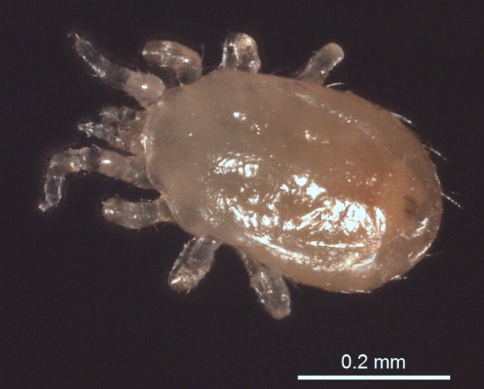
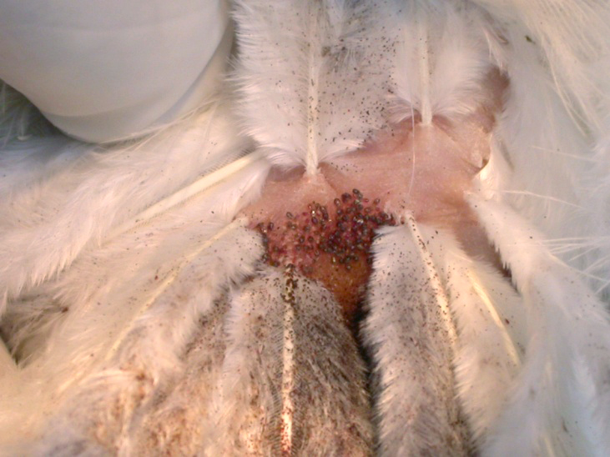
Ectoparasites
Northern Fowl Mite

Slide 4
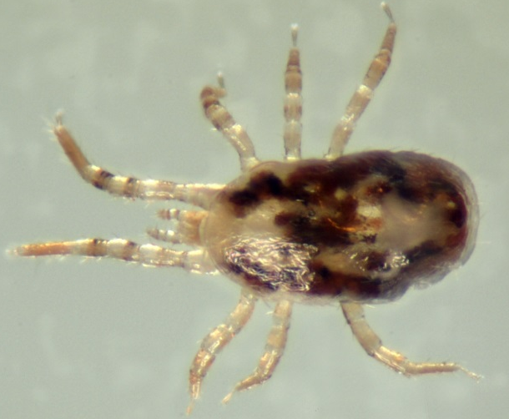
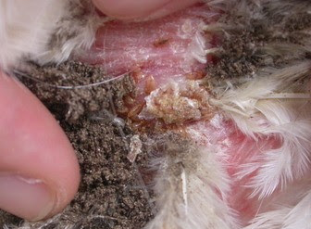
Ectoparasites
Chicken Mite

Slide 5
Ectoparasites
Chicken Lice

Slide 6
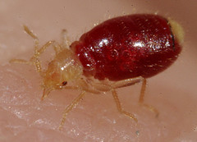
Ectoparasites - Bedbugs
Bed bug adult
Bed bug nymph
Bed bug infestation

Slide 7
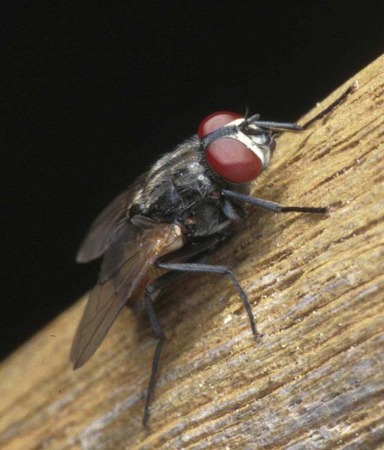
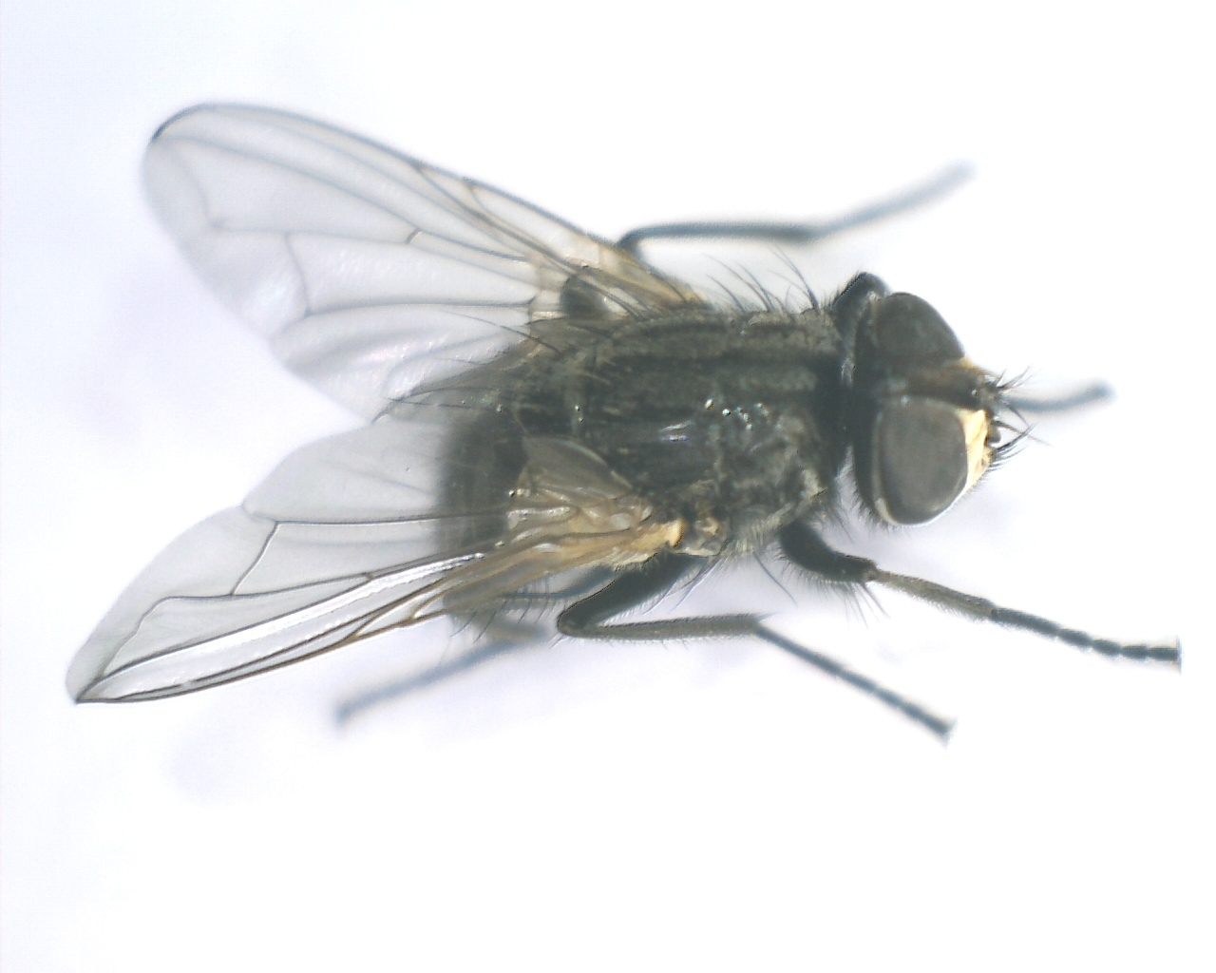
Environmental – Insect Pests House Fly

Slide 8
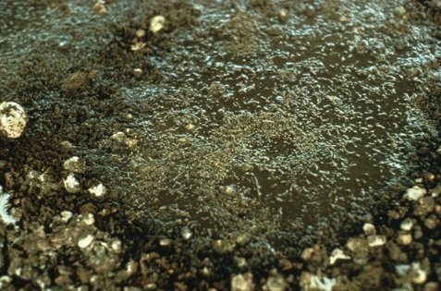
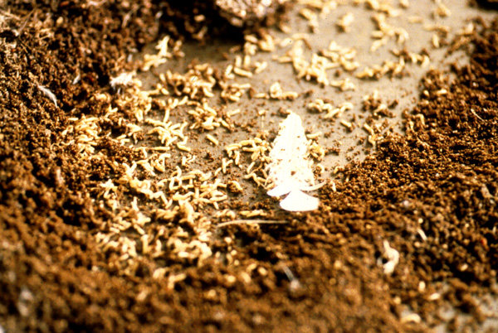
Environmental – Insect Pests House flies
House fly larvae in wet poultry manure
House fly larvae in chicken manure

Slide 9
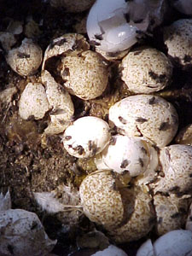
Environmental – Insect Pests House Flies
House flies on broken eggs, and fly specking

Slide 10
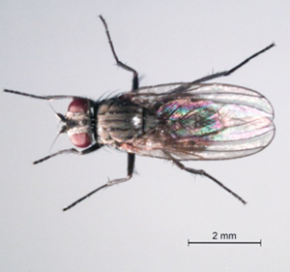
Environmental - Insects
Little House fly

Slide 11
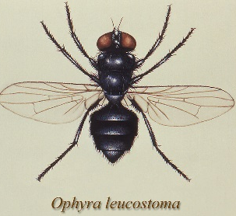
Environmental - Insects
Dump fly or Black Garbage fly

Slide 12
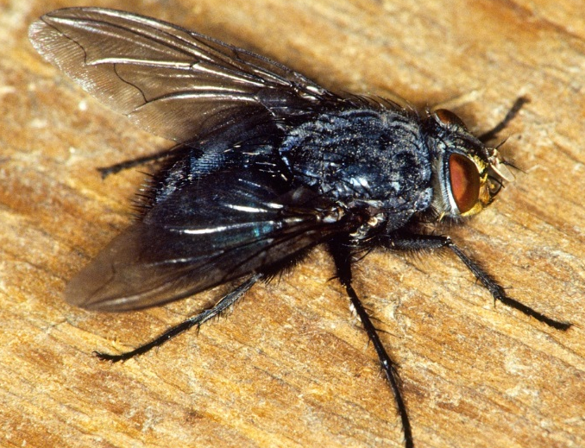
Environmental – Insects
Blow Flies
Green Bottle Blow fly
Blue Bottle Blow fly

Slide 13
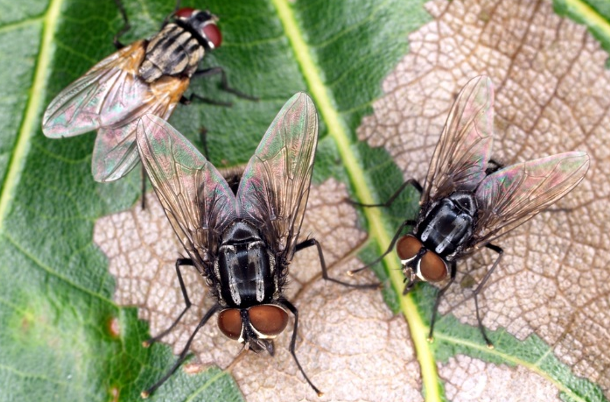
Environmental - Insects
Flesh flies

Slide 14
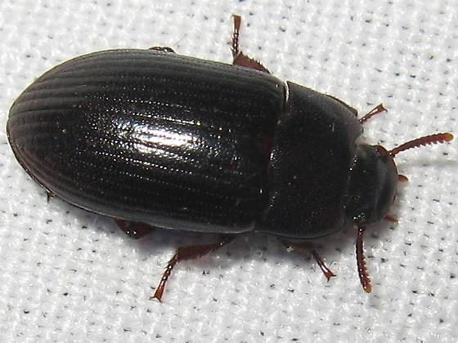
Structural Insect Pest –Darkling Beetle
Lesser mealworm (litter beetle) adult

Slide 15
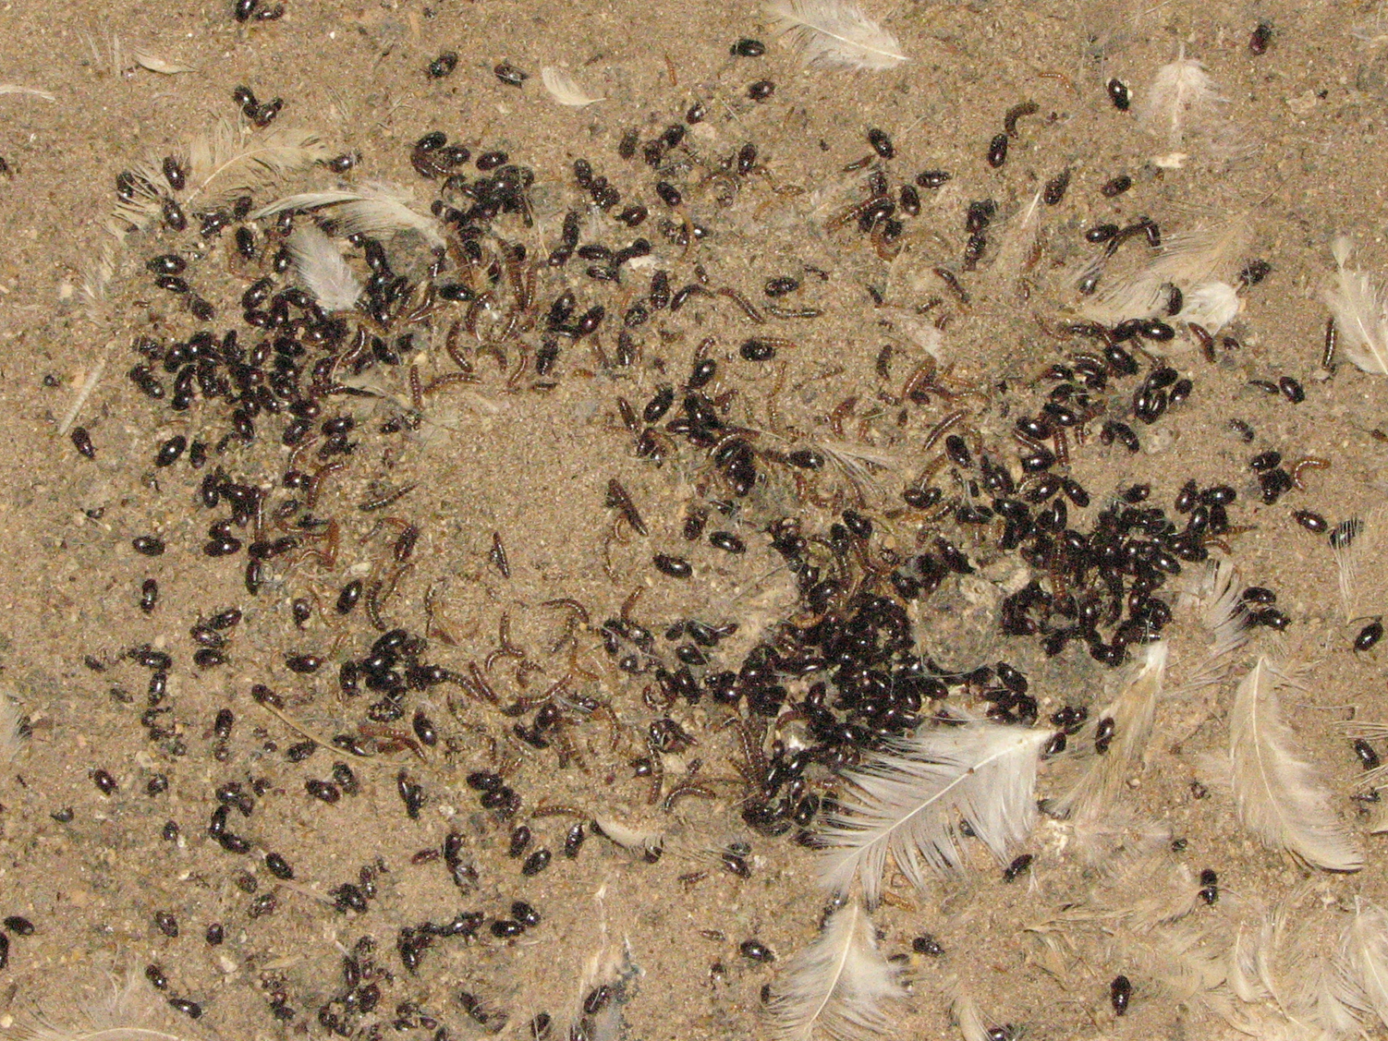
Structural Pest
Lesser mealworm (darkling beetle) adults and larvae

Slide 16
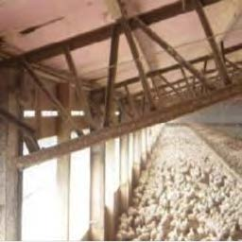
Lesser Mealworm (Darkling beetle/litter beetle)
Impact
(Univer. Of Ga., Coop. Poultry Ext.)
Darkling beetle damage to insulation and wood structure

Slide 17
Darkling Beetle (Litter Beetle) - Impact
Impact Feed Efficiency
Dispersal or Beetle Invasions
Vector of Pathogens
Marek’s disease
Gumboro disease
New Castle disease
Avian influenza
Bacterial pathogens
Human Health Concern

Slide 18
Darkling Beetle (Litter Beetle) Management
Cultural
Biological
Chemical

Slide 19
Dave Boxler
Extension Educator
West Central Research & Extension Center
North Platte, NE 69101
308-696-6721
dboxler1@unl.edu

