Slide 1
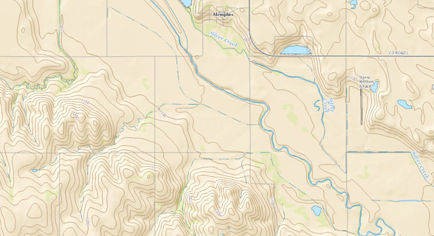
Maps of Value to a Site Review
Type of Map Key Information Why?
Plat Map Residences and Public Buildings ID Higher Risk Neighbors
Topo Map Intermittent &Perennial Manure Application Streams, Wetlands Setbacks
Web Soil Survey Soil Characteristics Land App Planning &
Siting of Storage
DNR Maps Well Locations Well Head Setbacks
Flood Plains Facility Locations
MO Ag Site Tool Report on Odor &
Water Risks

Slide 2
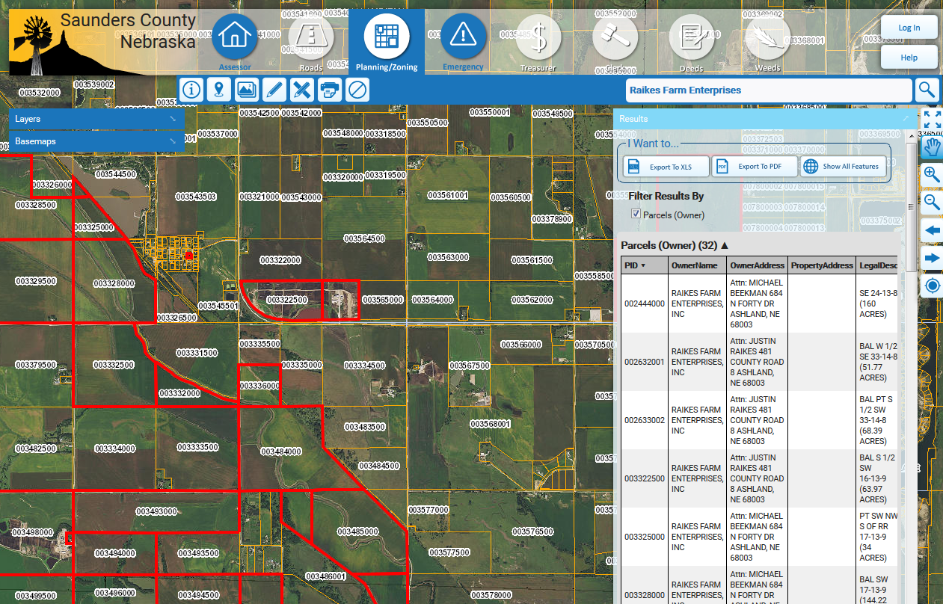
County GIS Workshop maps - http://www.saunders.gisworkshop.com/

Slide 3
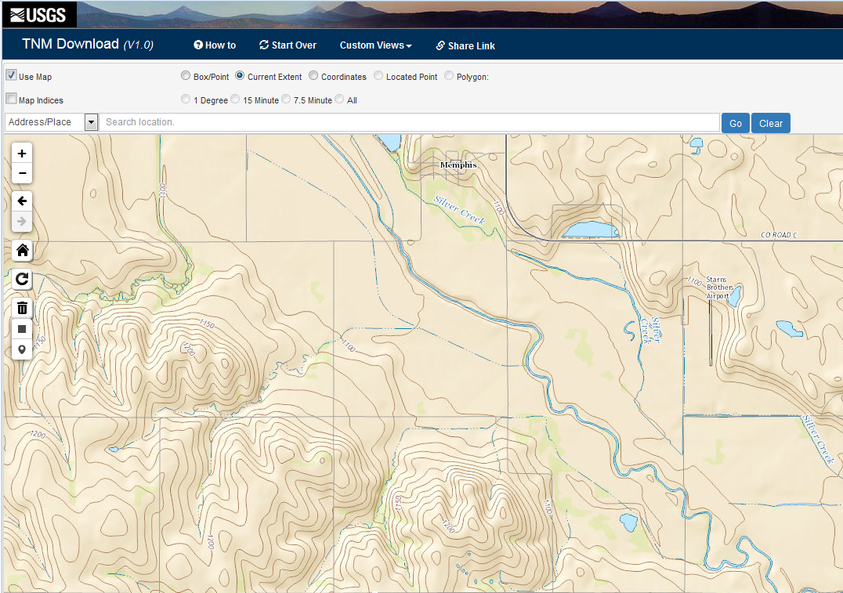
Topographic
Maps for streams
that may require
setbacks:
http://viewer.nationalmap.gov/viewer/

Slide 4
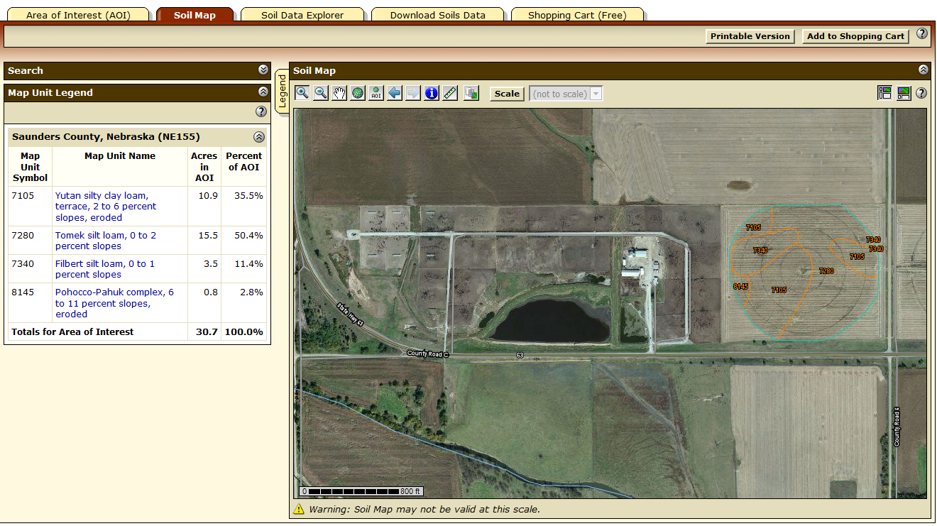
USDA Soil Survey: http://websoilsurvey.nrcs.usda.gov/app/WebSoilSurvey.aspx

Slide 5
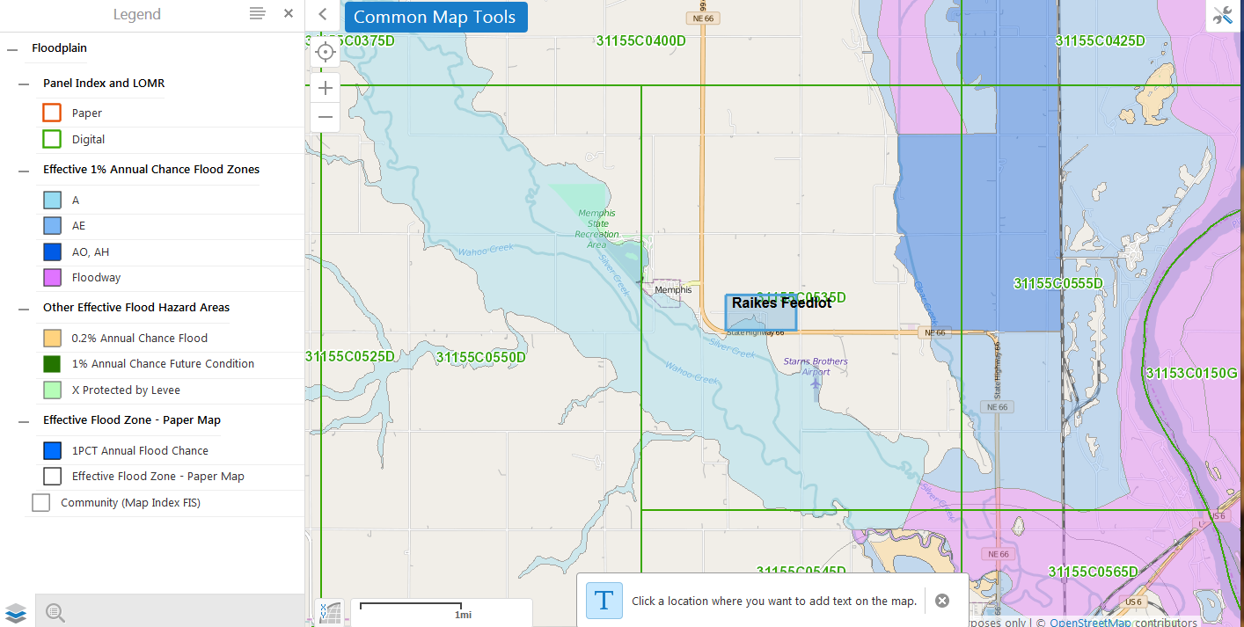
Nebraska Flood Plains: http://www.dnr.ne.gov/nebraska-interactive-maps

Slide 6
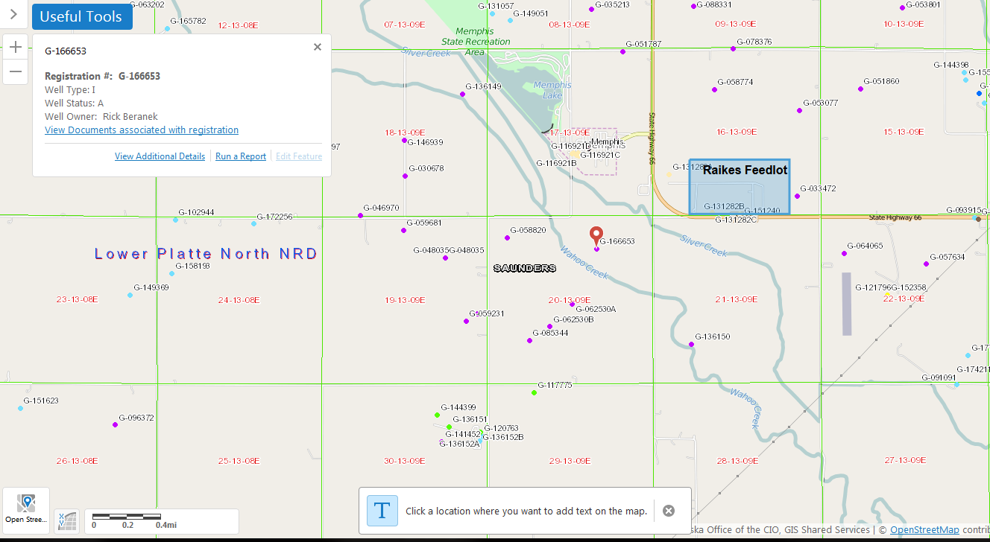
Nebraska Water Wells: http://www.dnr.ne.gov/nebraska-interactive-maps

Slide 7
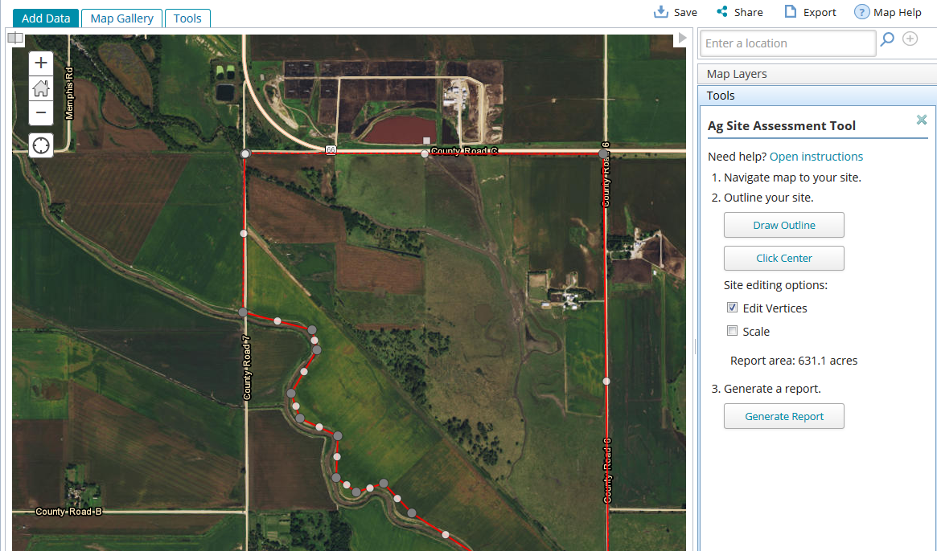
Missouri Ag Site Assessment tool: http://www.communitycommons.org/groups/agsite/

Slide 8
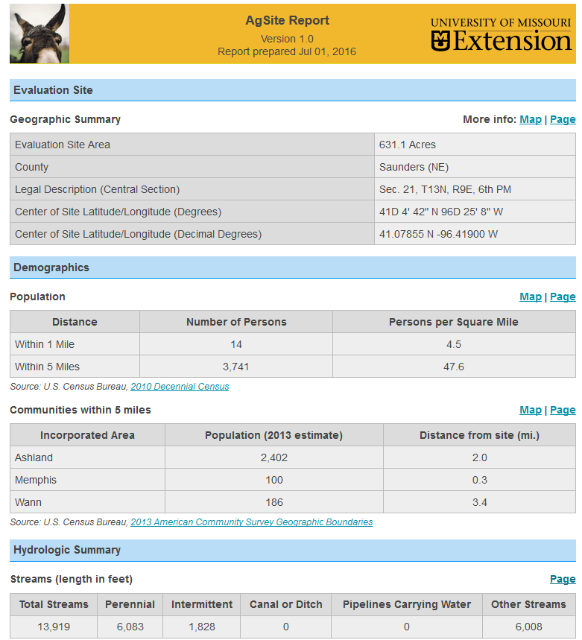
Missouri Ag Site Assessment tool: http://www.communitycommons.org/groups/agsite/

