Slide 1
Reverse Osmosis Rebate Program
In-Service
Treating high nitrate concentrations in private wells
Katie Pekarek, Water Quality Extension Educator
Laura Nagengast, Source Water Protection Extension Educator
Carla McCullough, Watershed Science Extension Educator
Becky Schuerman, Domestic Water, Wastewater Management Extension Associate
Notes:
**Introduce the speakers and give an overview of the In-Service program.**
Nebraskans have recognized that nitrate in groundwater has a significant impact on Nebraskans as a result of its presence in drinking water. Today’s in-service will focus on understanding one method which Nebraska legislators have recently identified as a priority to address high nitrate concentrations throughout the state – Reverse Osmosis.

Slide 2
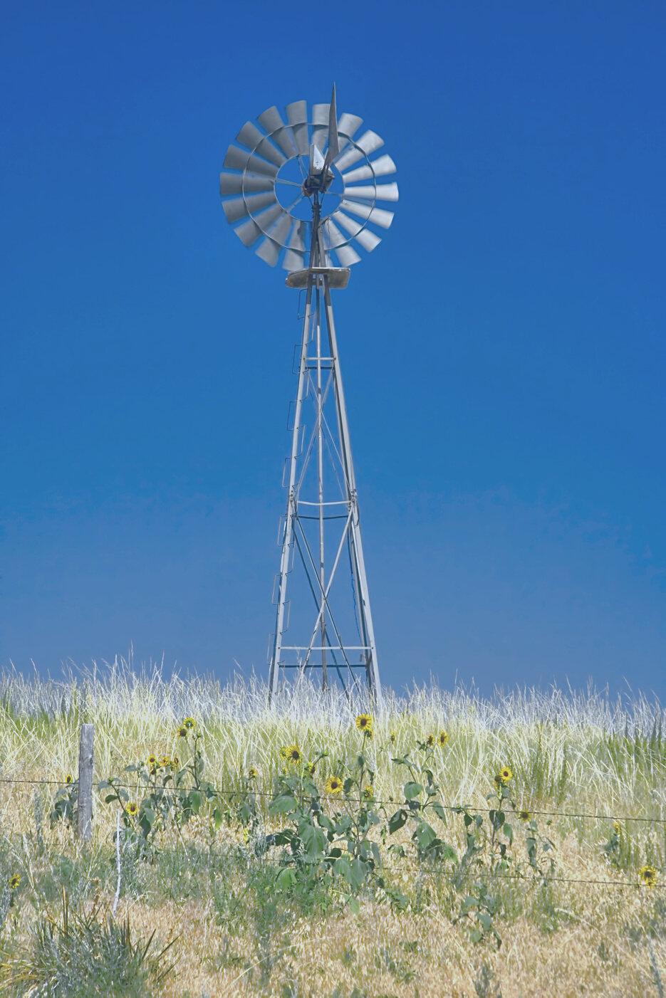
Discussion Outline
Nebraska Nitrate Trends
Nitrate and Human Health
Treating Drinking Water Nitrate
Reverse Osmosis Rebate
Program Overview
Notes:
More than likely, if you are participating in this in-service, you or one of your clientele have experienced high nitrate drinking water issues. That is really WHY we are all here today.
Today we will discuss what nitrate looks like in Nebraska and health impacts of nitrate in Nebraska. We will cover the of the basics treating drinking water for nitrate and walk you through a program that started on January 1, 2023 to help address nitrate issues through a rebate program for private drinking water well owners.

Slide 3
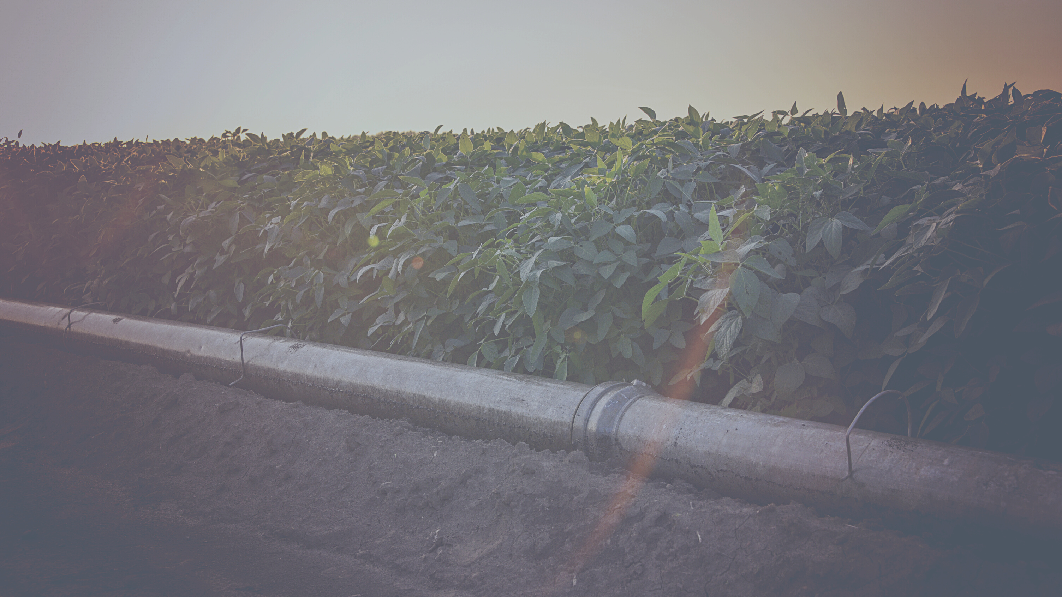
Nitrate in Nebraska
Nitrogen
Bacteria
Ammonium
Nitrate
Nitrite
Bacteria
Bacteria
Notes:
Nitrogen is a vital nutrient that helps plants and crops grow. It is essential to Nebraska's agricultural industry and economy. But `high concentrations in our water are harmful to people and nature.
When Nitrogen enters a soil system, bacteria in the soil convert atmospheric Nitrogen into Ammonium. Different bacteria then change ammonia into Nitrite. And yet another bacteria turns that into Nitrate. All these forms of nitrogen are available for plants - especially Nitrate, which is the easiest form for plants to use.
And that nitrate is why we’re here today. Nitrogen leaves the soil when a crop gets harvested, when it becomes gaseous and returns to the atmosphere, or when water carries it away to surface water or groundwater.
When nitrogen leaves the part of the soil where the roots are located, it becomes a liability for groundwater, surface water, and community vitality.

Slide 4
Maximum Nitrate in Drinking Water for Safety = 10 mg/L Nitrate-Nitrogen
Notes:
In Nebraska, approximately 88% of us get our drinking water from groundwater. If we don’t include MUD, which serves eastern Nebraska, that number goes almost to 100%. And nearly 100% of rural Nebraskans get their drinking water from groundwater. Now, if you live in town, or even if you live in an area where there are 25 or more water hook ups to a system, there are requirements for regular testing of the water, as well as treatment.
In regards to nitrate, the Maximum Contaminant Level set by the EPA is 10 mg/L OR 10 ppm. So you know that if you are in town, you are getting water that is safe to drink and nitrate will be less than 10 ppm, although it may not look or smell like you want.
Now rural Nebraskans, predominantly get their drinking water from private drinking water wells. There is no requirement for these individuals to test or treat their water. It is solely the individuals responsibility to make sure they have safe drinking water.

Slide 5
Nebraska Nitrate Trends
Alanex, Bronco, Cannon,
Crop Star, Lariat,
Lasso, and Partner
Bicep, Acuron, Brawl,
Dual II Magnum, Matador, Prefix and Sequence
Bladex, DW3418,
Fortrol, Match, and Payze
Sencor, Canopy
Nitrate in Nebraska
Notes:
So let’s look at Nitrate across Nebraska groundwater. Nebraska as a whole has been collectively sampling our groundwater since the early 1970s for several different components. Sampling is done by state, local and University partners. The water quality data is then submitted to an Agrichemical database that the University maintains. Since sampling reporting began, 241 different contaminants have been analyzed for in Nebraska. This table shows the most commonly found compounds in Nebraska's groundwater - these are the only 12 compounds which showed up more than 50 times. The one that shows up most is Nitrogen – 91% of the time.

Slide 6
Nebraska Nitrate Trends
Most recent recorded Nitrate-N
concentrations of 18,483 wells from 2001-2020
Understanding Nitrate in Nebraska
Notes:
So let’s look at this visually across the state. This map shows you the most recent recorded Nitrate levels all across Nebraska wells. Anything in green, is probably just background N. Anything in yellow or orange probably has some influence from human activity. Anything in purple or blue is already above the 10 ppm, meaning it is recommended that humans do NOT drink the water. These nitrate concentrations are also a concern for livestock producers, especially as it relates to reproduction.

Slide 7
Nebraska Nitrate Trends
Statewide Number & Median of Nitrate Analyses, 2001-2020
9
8
7
6
5
4
3
2
0
Understanding Nitrate in Nebraska
Notes:
So as a state, our average nitrate concentrations have increased from just above 5 mg/L to above 6 in the course of 20 years.

Slide 8
Nebraska Nitrate Trends
Median of the most recent Nitrate-N concentration by township of 18,483 wells from 2001-2020
Understanding Nitrate in Nebraska
Notes:
But more importantly than our statewide average is what our nitrate concentrations look like locally. This map shows you nitrate concentrations by townships. If you are serving any of the areas that are in orange, purple or blue, you likely have clients that are already above the safe drinking water standard.
If you have areas that are yellow, you may have a few spots where water quality is really good and some where water quality is poor.
Each case will be different. The quality of the water as it pertains to nitrate will depend on the land practices in the area, the depth of the well, the soil type, the screening depth (or where the water is pulled from), and both historical and current activities in the area.
So the question we want to address now is: why do I care if the nitrate is high?

Slide 9
Nitrate and Human Health
Notes:
Nitrogen is a vital nutrient that helps plants and crops grow. It is essential to Nebraska's agricultural industry and economy. But `high concentrations in our water are harmful to people and nature.
When Nitrogen enters a soil system, bacteria in the soil convert atmospheric Nitrogen into Ammonium. Different bacteria then change ammonia into Nitrite. And yet another bacteria turns that into Nitrate. All these forms of nitrogen are available for plants - especially Nitrate, which is the easiest form for plants to use.
And that nitrate is why we’re here today. Nitrogen leaves the soil when a crop gets harvested, when it becomes gaseous and returns to the atmosphere, or when water carries it away to surface water or groundwater.
When nitrogen leaves the part of the soil where the roots are located, it becomes a liability for groundwater, surface water, and community vitality.

Slide 10
Nitrate and Human Health
MCL of nitrate in drinking water (10mg/L) is set for infant development of methemoglobinemia
Not for other health outcomes
Studies of other health outcomes continue to be published
High concentration of nitrate in drinking water have been linked to other adverse health outcomes
Strongest links:
Minor health ailments
Methemoglobinemia
Preterm birth issues
Birth defects
Pediatric cancers
Adult cancers
Nitrate and Human Health
Notes:
So, as you’ll recall, the maximum contaminant level for nitrate and drinking water is 10 parts per million, and this was set for infant development of methemoglobinemia.
So in the late 19 hundreds physicians started seeing a lot of cases of infants experiencing methemoglobinemia, and they discovered that all of these infants were drinking formula that was mixed with levels water that had high nitrate concentrations. What they found was that at 10 ppm, infants seemed to avoid this condition. But note, this was not set for any other health outcomes.
So in the late 19 hundreds, many studies have come out trying to understand if there are any other health outcomes related, and these studies continue to be published. Some have taken place right here in Nebraska by the University of Nebraska Medical Center and the University of Nebraska, Lincoln, and they have found that higher concentrations of nitrate and drinking water have been linked to other for health outcomes as well. So the strongest links are minor health ailments, methemoglobinemia, pre-term birth issues, birth defects, pediatric cancers and adult cancers.

Slide 11
Adult Health Research
Minor health ailments: increased heart rate, nausea, headaches, abdominal cramps
Cancers potentially associated:
Colorectal cancer
Thyroid disease
Kidney cancer
Bladder cancer
Non-Hodgkin lymphoma
Alzheimer's, Diabetes and Parkinson's Disease
Maternal/Fetal Health Issues
Miscarriages
Preterm births
Fetal growth restrictions
Birth defects
Nitrate and Human Health
Notes:
So this is just a summary of some of the adult health research that's been going on relating nitrate contaminated water and human health. So, as I just mentioned, the minor health ailments such as increased heart rate, nausea, headaches, abdominal cramps.
Cancers are highly studied in relationship to nitrate and potentially associated cancers are colorectal cancer and thyroid disease. They're the most common cancers we've been seeing as well as kidney cancer, bladder, cancer, and non hodgkin's lymphoma.
Other studies have tried to see the link between Alzheimer's diabetes and Parkinson's. That research is relatively newer and still happening.
And finally, maternal and fetal health issues are of high concern and very important. We focus a lot of our efforts on and those involved miscarriages, preterm births, fetal growth with dis restrictions and birth defects.

Slide 12
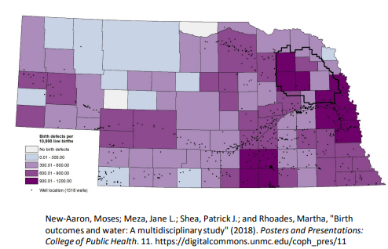
Birth Defects in Nebraska
National average: 3.3% of all live births
Nebraska (2005-2015) 5.8%
Counties in parts of NE reach 9-12%
Counties with higher birth defects had greater prevalence of agrichemicals in water
Nitrate and Human Health
Notes:
So I wanted to show this map just to kind of give you all an idea of birth effects in Nebraska. So the national birth effect. rate is 3 point. 3 of all live births, and the average rate in Nebraska is 5.8%.
The darker purple is where there are higher rates of birth defects as compared to lighter purple where there are fewer birth defects seen, and especially over in eastern Nebraska, you can see that some counties reach 9 to 12% of all live births, which is triple or quadruple the national average.
This is really concerning and they also found that these counties, with the higher birth defects, have had a greater prevalence of agricchemicals in the water.

Slide 13
Health Issues in Children Research
Multiple health issues have been identified in children
Methemoglobinemia (Infants less than 6 months)
Pediatric brain cancers
Non-Hodgkin Lymphoma
Non-Hodgkin Lymphoma had a three-fold increase in risk with nitrates and atrazine in Nebraska study (Rhoades et al 2013)
Nitrate and Human Health
Notes:
So there's also been health issues in Children's Research as well
Methemoglobinemia and blue baby syndrome has been found within infants less than 6 months. Pediatric brain cancers and Non-hodgkin's lymphoma have also been identified to have strong links with high nitrate concentrations in drinking water.
Martha Rhodes did a partner study right here in Nebraska, and she found that with non-hodgkin's lymphoma, there is a three-fold increase in risk with nitrate and atrazine in the water in the Nebraska study increased risk of developing on Hodgkin's lymphoma.

Slide 14
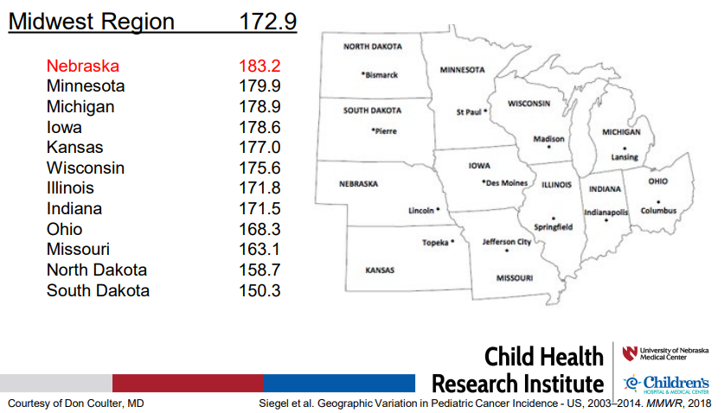
Pediatric Cancer in Nebraska
Incidence of pediatric cancers in Nebraska is among the five highest in the United States (Farazi et al., 2018).
(Data from 2003-2014 and reported as age-adjusted incidence rates of childhood cancer per 1 million)
Nitrate and Human Health
Notes:
In Nebraska, we have a high rate of pediatric cancer. Our incidence is among the top 5 States in the entire U.S. and within the midwest we have the highest rate. So, as you can see on this map, the average Midwest incidence of pediatric cancer is 172.9, and our average instance within Nebraska is 183.2.
So regardless of age, there are significant health implications of having high nitrate concentrations in Nebraskan’s drinking water.

Slide 15
Treating Drinking Water Nitrate
Notes:
Nitrogen is a vital nutrient that helps plants and crops grow. It is essential to Nebraska's agricultural industry and economy. But `high concentrations in our water are harmful to people and nature.
When Nitrogen enters a soil system, bacteria in the soil convert atmospheric Nitrogen into Ammonium. Different bacteria then change ammonia into Nitrite. And yet another bacteria turns that into Nitrate. All these forms of nitrogen are available for plants - especially Nitrate, which is the easiest form for plants to use.
And that nitrate is why we’re here today. Nitrogen leaves the soil when a crop gets harvested, when it becomes gaseous and returns to the atmosphere, or when water carries it away to surface water or groundwater.
When nitrogen leaves the part of the soil where the roots are located, it becomes a liability for groundwater, surface water, and community vitality.

Slide 16
Nitrate Treatment Systems
Household Treatment system:
Treats all water flowing through the house to reduce the concentration of nitrate in the water.
Point of Use (POU) system:
Provides a centrally located tap to reduce the risk of adverse health effects through the ingestion of nitrate.
REVERSE OSMOSIS (RO)
DISTILLATION
Treating Drinking Water Nitrate
Notes:
There are two primary approaches to treating water that has a high nitrate concentration in a private drinking water well. The first approach is to treat all water flowing through the house. This treatment typically occurs where water enters the house. While this provides a method of making sure all water in a house has nitrate concentrations below the MCL of 10 parts per million, it is also a potentially costly system to install and maintain.
A point of use system is the second approach. Point of use systems basically treat the water ONLY where someone would drink the water. For example a system might be put in place to treat water at the kitchen sink and then everyone in the household would be expected to only drink from this faucet.
Household treatment systems and point of use systems typically installed in Nebraska are either Reverse Osmosis systems or distillation systems. For the purpose of today, we will focus on the RO systems, as these are the focus of the program we are discussing.

Slide 17
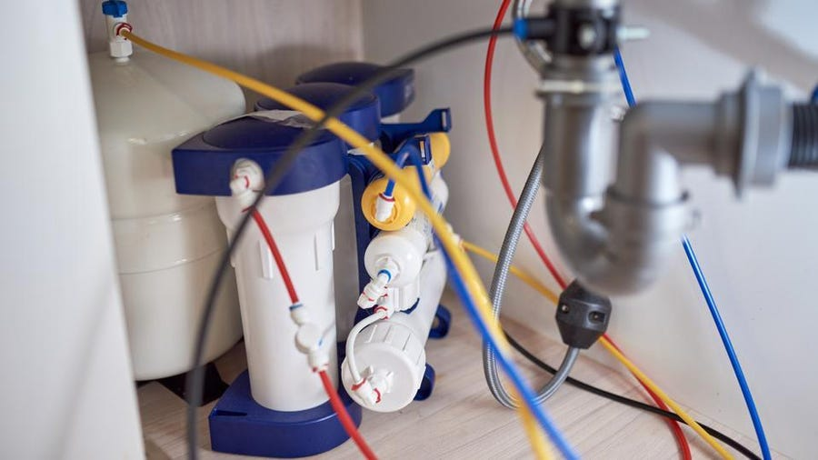
Reverse Osmosis (RO)
Pressure driven membrane process
>95% removal of most contaminants
Pretreatment may be required:
Sediment filters
Water softening
Photo credit: Forbes.com
Treating Drinking Water Nitrate
Notes:
Let’s talk about Reverse Osmosis. Generally, Reverse Osmosis systems are pressure-driven membrane systems. They remove over 95% of most contaminants. These systems can be used for a variety of different contaminants, so it is important to note that a specific membrane is required to treat the drinking water for nitrate.
Further, to prolong the functioning of these systems, pre- treatment is often required. This typically might mean sediment filters or water softening.

Slide 18
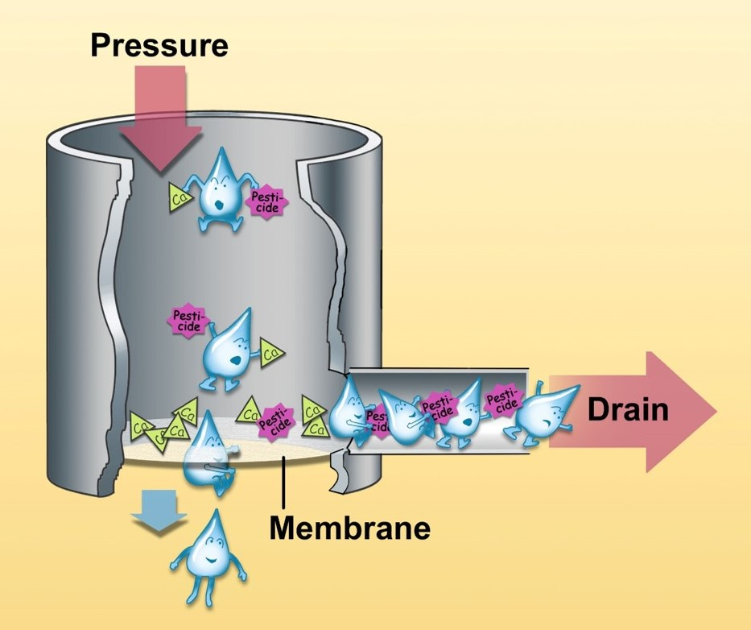
Reverse Osmosis (RO)
Treating Drinking Water Nitrate
Notes:
This graphic gives you an idea of how a pressure driven RO system works. The water droplets are forced, under pressure down through a membrane. The water that goes out the drain does not fit through the membrane because it has the contaminant you are concerned with, in this case, nitrate. The clean water is forced through the membrane and then made available for use. The water that goes through the drain exits as wastewater, likely contributing to a septic system or lagoon in rural Nebraska.

Slide 19
RO System Costs
Point-of-Use System
System itself: $200 - $2000 +
Point of Use Installation: $100 - $800 +
Maintenance: $50 - $200+
Whole House System
Largely dependent on water use factors
Estimates from $10,000+ for a 2 person household and up
Treating Drinking Water Nitrate
Notes:
The average cost of point of use systems are between $200 and $2,000, really depending on all the features that may be needed for a system.
Installation costs are another consideration and may range from $100 to $800+ again, depending on the type and complexity of your system.
And within the program we are talking about today, it is important to note that a plumber or certified installer must install the system to be eligible for this rebate program.
And then, of course, then, there's the cost of the maintenance and operation of the systems. This ranges from $50 to $200 per year, depending on how many filters must be replaced.
Whole house systems are a little more difficult to estimate costs. However, for an average 2 person household system, the cost is typically around $10,000 and up, depending on estimated water usage for the household.
Maintenance is essential to the successful use of these systems, so it may be worth considering additional costs for a maintenance contract on the system.

Slide 20
Lifetime Treatment Considerations
Regular Maintenance
Pre- and Post- Filter replacement
Contaminant concentration influences how long filters work
Increased wastewater loads to septic systems and lagoons
Treating Drinking Water Nitrate
Notes:
As with any drinking water treatment system, it is only as good as it is maintained. Regular maintenance is important to extend the life of the system and to help ensure peak performance.
Pre-filters and post-filters require regular replacement. The length of time before pre-filter replacement depends upon water volume, quality and contaminant concentration.
Post-filter replacement also depends on contaminant concentration, as well as membrane rejection percentages and AC removal efficiency. Manufacturers and dealers can assist in determining replacement intervals.
Typically, the waste from an RO System will go to wastewater, increasing the load on your septic system.

Slide 21
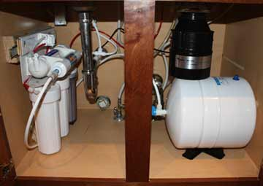
RO Rebate Program Overview
RO Rebate Program Overview
Notes:
Now lets talk about an opportunity we have here in Nebraska in 2023 and 2024.
So in 2023, the Nebraska Legislature passed LB1014. This bill took 4 million dollars from the American Rescue Plan Act and allocated it to treating nitrate issues in Nebraska. 1.2 million dollars of that is dedicated to this Reverse Osmosis Rebate program that is for private well owners.
So the general idea of the program is that any individual private drinking water well owner can test their water AND if the nitrate concentration comes back above 10 ppm, they might be eligible for UP TO $4,000 support to get a reverse osmosis system to treat their nitrate. So let’s dig into details.

Slide 22
RO Rebate Program Overview
Application Opens: January 1, 2023
Application Closes: June 24, 2024
Who’s Eligible?
This program is open to anyone with a private well.
The private well must be registered.
Applicants will need to submit water quality data from the State laboratory, with testing results dated no earlier than January 1, 2022.
Only wells with samples above 10 ppm nitrate will be eligible for this program.
RO Rebate Program Overview
Notes:
So in 2023, the Nebraska Legislature passed LB1014. This bill took 4 million dollars from the American Rescue Plan Act and allocated it to treating nitrate issues in Nebraska. 1.2 million dollars of that is dedicated to this Reverse Osmosis Rebate program that is for private well owners.
So the general idea of the program is that any individual private drinking water well owner can test their water AND if the nitrate concentration comes back above 10 ppm, they might be eligible for $4,000 support to get a reverse osmosis system to treat their nitrate. So let’s dig into details.

Slide 23
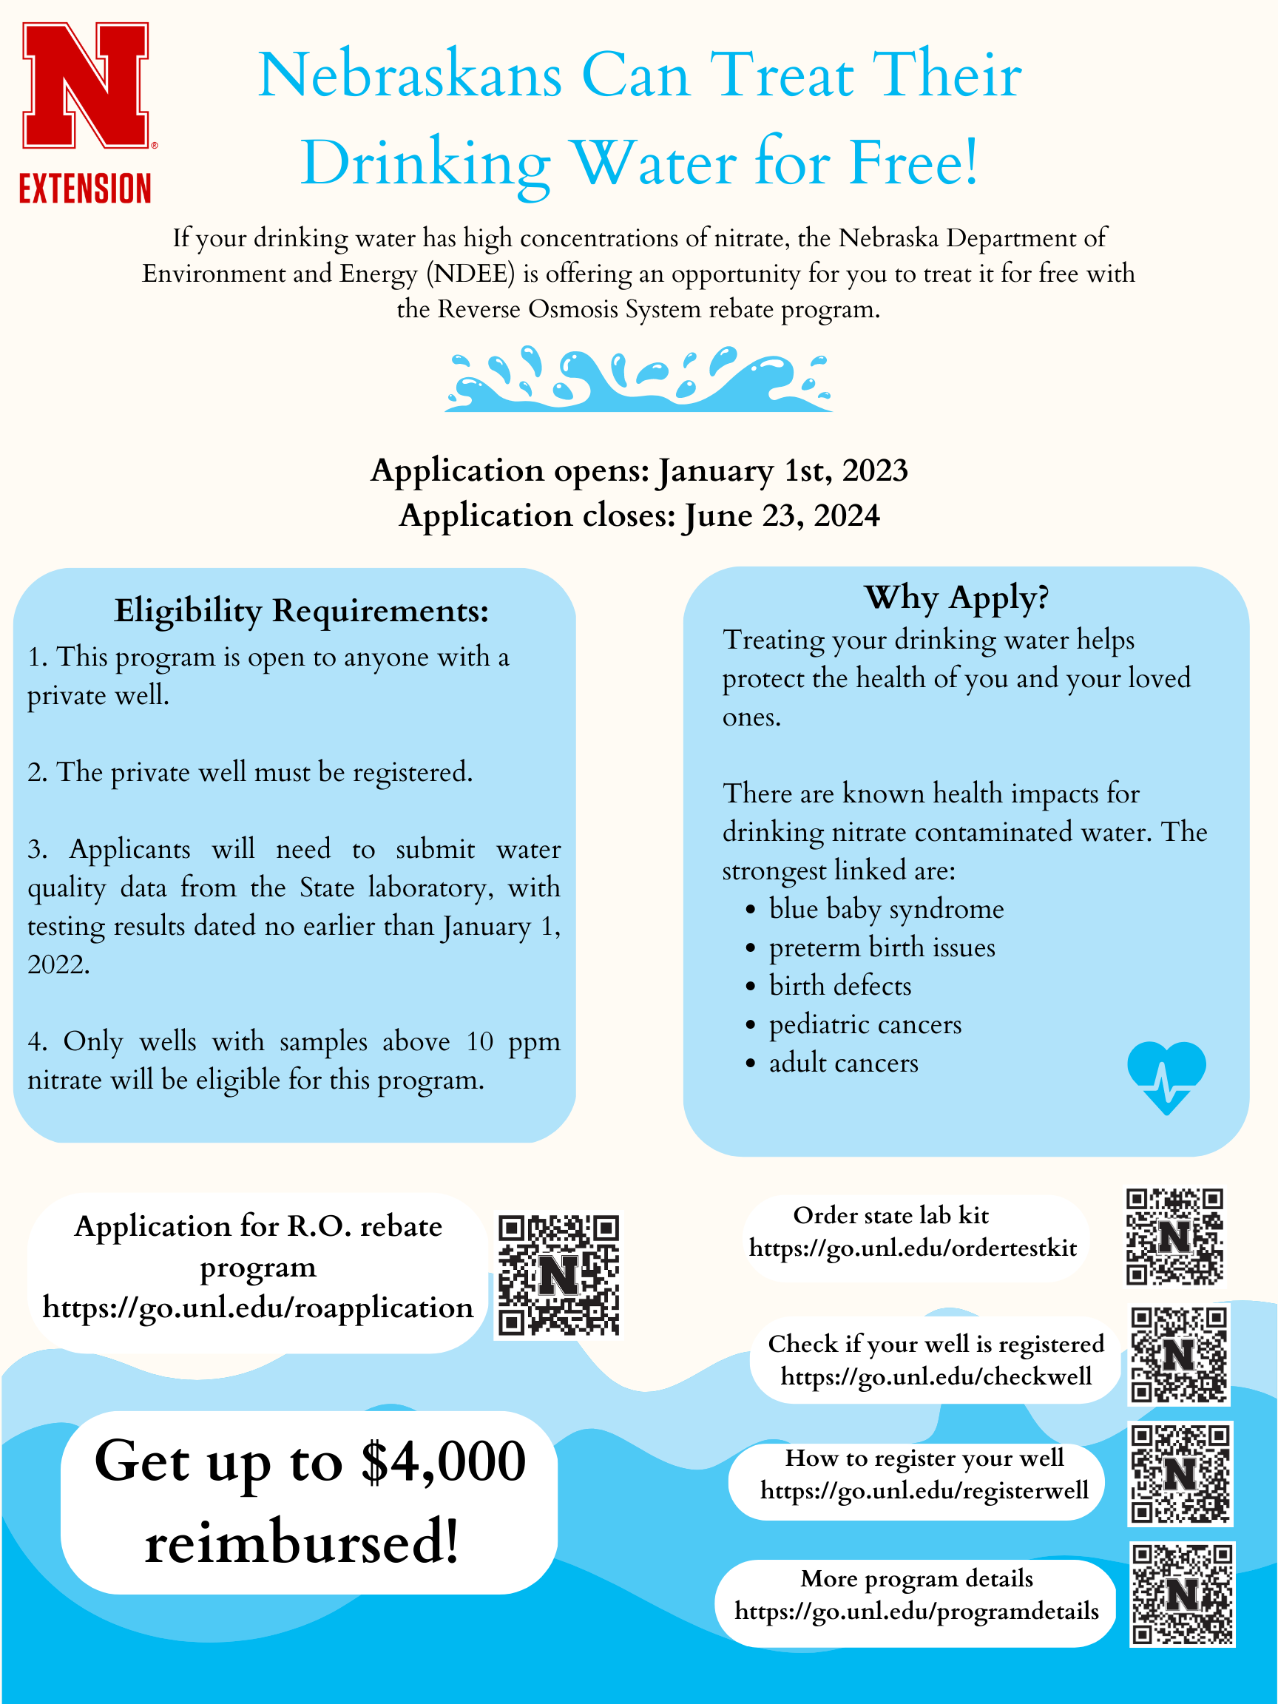
RO Rebate Program Overview
RO Rebate Program Overview
Notes:
Now, the devil is in the details, so I am going to walk you through a couple of things. We have a pdf that we will send out immediately after this in-service with all of the links and resources I am going to show you.

Slide 24
RO Rebate Program Overview
How to Apply
Test your well water with the State laboratory.
If your nitrate concentration is higher than 10ppm, go to https://go.unl.edu/reapplication.
Mail or email your application to NDEE.PrivateWellRORebate@nebraska.gov
RO Rebate Program Overview
Notes:
The first step in this process is to get your water tested.
*at this point, follow QR code and walk participants through getting a test kit. Then follow the link in step 2 walk the participants through the application*

Slide 25
RO Rebate Program Overview
Check Your Well Registration
RO Rebate Program Overview
Notes:
Now follow the 1st QR code and show participants how to check if their well is registered.
Follow the second QR code to show participants how to register a well, if needed.

Slide 26
RO Rebate Program Overview
Get a cost estimate from one of the following:
Licensed plumber
Entity that has performed at least 5 successful Private Well Reverse Osmosis Small Water Treatment Installations
This estimate must contain a written clause that states the installer
“will not charge for the installation of the installation unless post-installation testing from the state laboratory has nitrate levels below 10 mg/L”
RO Rebate Program Overview
Notes:
After you’ve tested your water, and checked your well registration, it is time to get a cost estimate. You can either get one from:
A Licensed plumber, or
Entity that has performed at least 5 successful Private Well Reverse Osmosis Small Water Treatment Installations.
This cost estimate must contain a written clause that states the installer “will not charge for the installation of the installation unless post-installation testing from the state laboratory has nitrate levels below 10 mg/L”

Slide 27
RO Rebate Program Overview
Apply for the RO Rebate Program
RO Rebate Program Overview
Notes:
Finally, once this is done follow the QR code to apply.
*follow the code and show participants the application*

Slide 28
Nitrate and RO In-Service – THANKS!
RO Rebate Program Overview
Notes:
While this program may seem a bit complicated, Nebraska Extension is well equipped to serve our clientele as we engage with our program participants to make sure all Nebraskans have safe drinking water.
*at this point, stop and take questions*

