Slide 1
Building Public Trust in New/Expanded Livestock Production: More than Checking off Boxes Livestock & Poultry Expansion Webinar Series Webinar #7 August 8, 2016
Rick Stowell
Extension Specialist – Animal Environment
Biological Systems Engineering & Animal Science
University of Nebraska-Lincoln

Slide 2
Why do local residents oppose new/expanded AFO?
Concern for health, well-being
Family members
Farm animals
Fear of the unknown
See a ‘lose/win’ proposition
Bad history or memories
Limited sense of control
Only chance to influence situation
No New AFO

Slide 3
Addressing health & well-being [environmental] concerns
Incorporate concerns into planning [esp. site selection]
Know issues and risk factors
Be prepared to communicate how concerns were addressed
Acknowledge concerns
Why the site/AFO presents low risk
Evaluate multiple sites
Compare more than just AFO benefits and costs

Slide 4
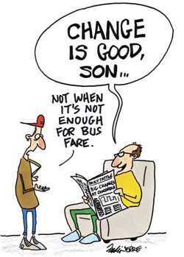
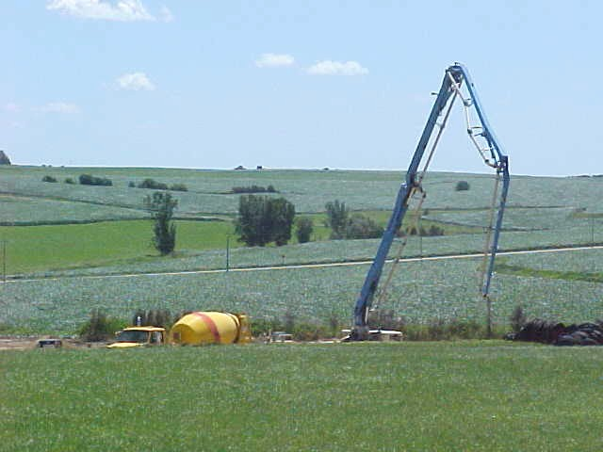
Addressing fears of the unknown
Know the local scene/culture
Why is it difficult to expand in areas that need animal Ag [and manure nutrients] most?
Keep lines of communication open
Demonstrate attention to detail
≠ Sharing details of AFO
Build upon experience
Visit existing AFO

Slide 5
Addressing ‘lose/win’ perceptions
Make clear that ‘investing in community’
Local crop farmers engaged?
Jobs for existing residents?
Using local suppliers?
Limited reliance on TIF?
Show that decisions not just about AFO
Describe how will be a part of community
Owner / operator live in area?
Returning next generation of farm family? or new career opportunities for young people?

Slide 6
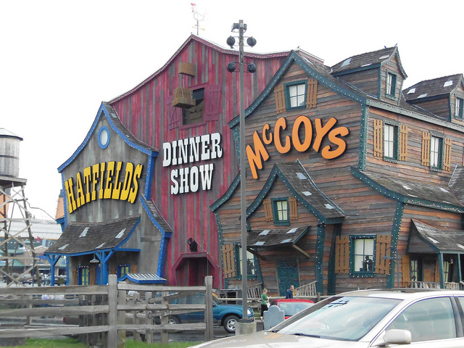
Addressing bad history/memories
Demonstrate a high bar, good reputation
Your operation
Others in industry
Determine what you’re up against early
Show how is / will be different and better

Slide 7
Addressing residents’ limited sense of control
Be a good listener
Identify potential areas for compromise in advance
Possible places to engage residents in decision-making
vs.

Slide 8
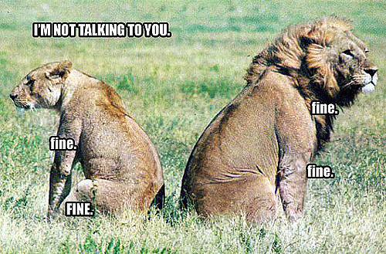
Take-Home Messages: Signs of Impending Trouble
Clearly doing the minimum / only what’s required in all decisions
Attitude is obviously “…because we can.”
Dismissing residents concerns and potential risks
Breakdown of communication
Minimum setback

Slide 9
Take-Home Messages: Growth can happen in Nebraska
AFO are being successfully sited and approved
Communities with animal ag presence tend to be more vibrant and resilient

Slide 10
Rick Stowell, Ph.D., P.E.
Associate Professor
Extension Specialist – Animal Environment
Department of Biological Systems Engineering
215 L.W. Chase Hall
Lincoln, NE 68583-0726
(402) 472-3912
rstowell2@unl.edu

